Slide 1

Departmental Review 2024/5

Slide 2
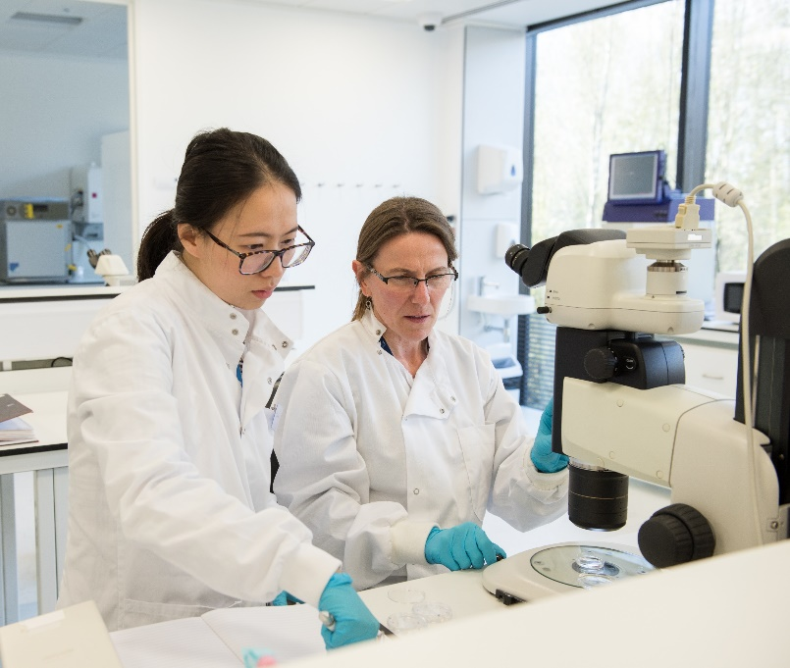


A periodic review
In Michaelmas Term 2024 it will be RDM’s turn to undergo a departmental review
All departments are regularly reviewed, as part of the University's quality assurance regime, by the University's Education Committee and the academic Division to which they belong (for us, the Medical Sciences Division).
The review will assess our academic vision, mission and strategy
Radcliffe Department of Medicine

Slide 3



An exciting opportunity
This is a great opportunity to focus our vision
It will allow us to look at our aims and strategies and the support in place for enabling them
Engaging with the review process will help us plan how to move forward
Radcliffe Department of Medicine

Slide 4
Preparing for the review (April–July 2024)
We have engaged two external consultants to help us prepare for the review
They are speaking with staff and student representatives between April and June
Please make time to speak with the consultants if you are invited to do so
There will be the chance to speak with them if desired
The consultants’ reports will help us prepare our Self-Evaluation Document to submit to the review panel
Radcliffe Department of Medicine

Slide 5
The review process (Sept 2024–2025)
RDM's Senior Leadership Team will write a 'Self-Evaluation Document' (SED) for the University review panel, which will have members from within and beyond the University. The SED will cover our view of our vision, mission, strategies and the support to enable them.
The review panel will spend two days (expected to be in December) reading our Self-Evaluation Document, looking at a range of data about RDM, talking to invited staff and students, and then writing a report with recommendations.
RDM's Senior Leadership Team will be invited to provide responses to the review panel's recommendations. We expect that the review report and the departmental response will then be considered by the Medical Sciences Division and University's Education Committee.
Once an agreement has been reached on how to proceed, we will plan the implementation phase.
Radcliffe Department of Medicine

Slide 6
Questions the review will help us to consider
How might we want to redefine our scientific priorities?
Are we using our existing resources wisely? People, money, space etc.
What is the optimal size and shape for RDM?
Where do our future opportunities lie?
What can we do better?
Radcliffe Department of Medicine

Slide 7
More information and contact
If you have any questions about the review process please contact communications@rdm.ox.ac.uk
See also the dedicated departmental review webpages https://www.rdm.ox.ac.uk/intranet/departmental-review-2024 (SSO required)
Keep an eye on the weekly RDM bulletin for updates on how the process is going
Radcliffe Department of Medicine

Slide 8


