Slide 1
Opportunities for RDM – Building for the Next 10 Years
Radcliffe Department of Medicine Annual Symposium April 2022
Prof Keith Channon

Slide 2
Radcliffe Department of Medicine (RDM)
Prof Keith Channon
RDM Strategic (RDMS)
Division of Cardiovascular Medicine
(CVM)
Investigative Medicine Division
(IMD)
Nuffield Division of Clinical Laboratory Sciences (NDCLS)
Oxford Centre for Diabetes, Endocrinology & Metabolism (NDCLS)
Prof Stefan Neubauer
Prof Alison Simmons
Prof Deborah Gill
Prof Fredrik Karpe
MRC Weatherall Institute of Molecular Medicine (WIMM)
Prof KJ Patel

Slide 3
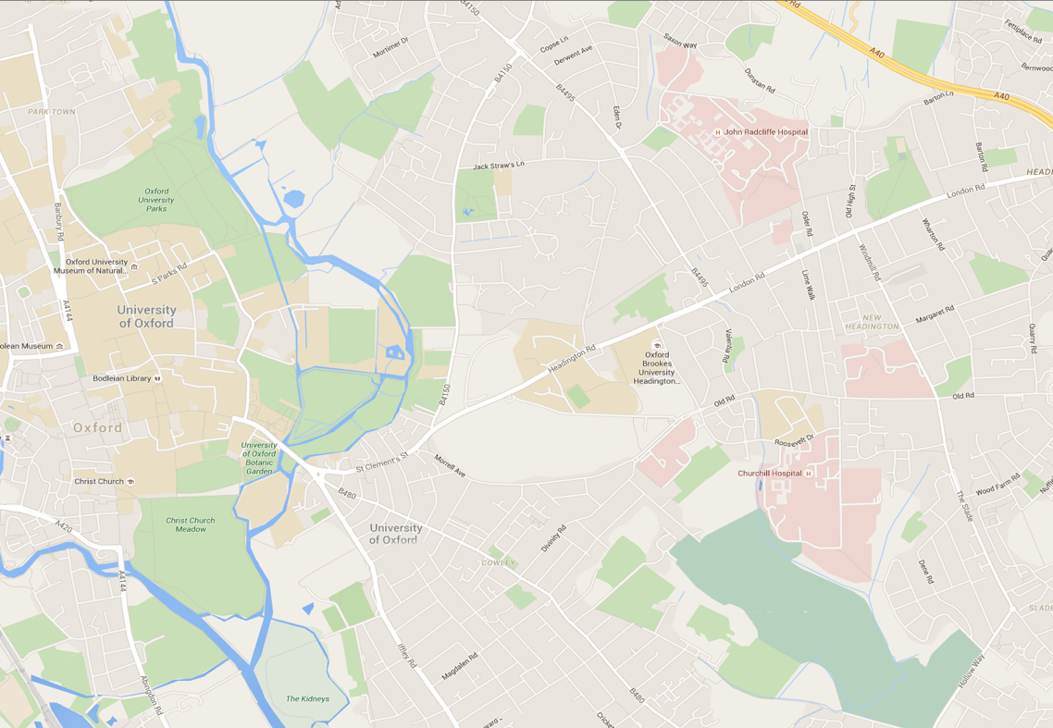
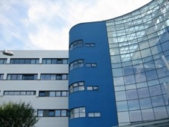
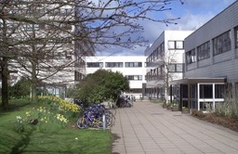
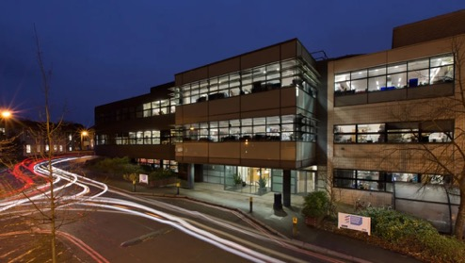
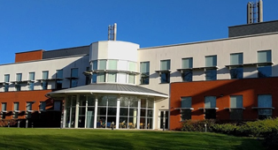
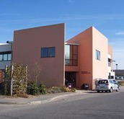
Radcliffe Department of Medicine: Places
1
John Radcliffe Hospital
1
2
3
2
Old Road Campus
3
Churchill Hospital

Slide 4
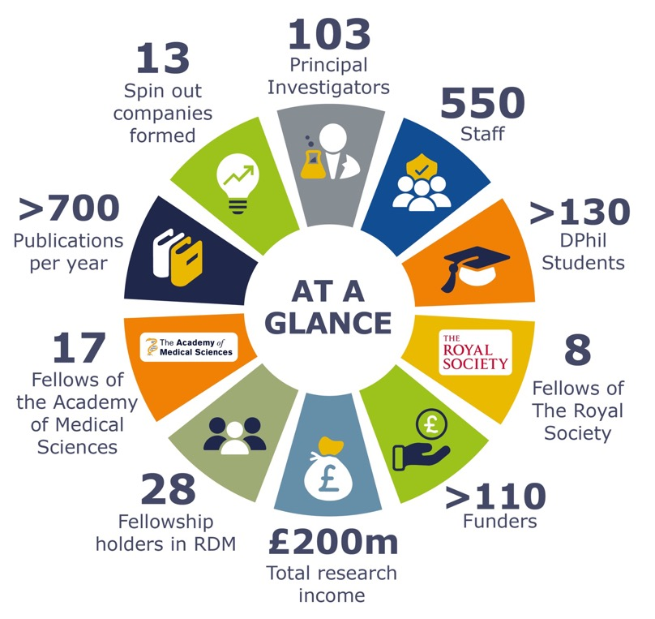
Radcliffe Department of Medicine: People
150 PSS and 400 researchers
PIs per division - 33 CVM, 27 WIMM/NDCLS, 14 NDCLS, 13 OCDEM, 10 WIMM/IMD, 6 IMD
51 Full Profs, 31 APs, 4 URLs
62 new PIs appointed since RDM was formed
8 FRS
11 NIHR Senior Investigators
17 F Acad Med Sci
6 EMBO members
2 EMBO young investigators
Young Researcher Prizes – many every year
BRC themes – 8 RDM PIs involved in leading 6 themes in current BRC

Slide 5
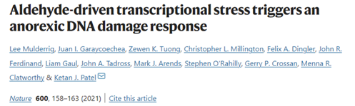
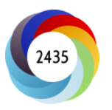
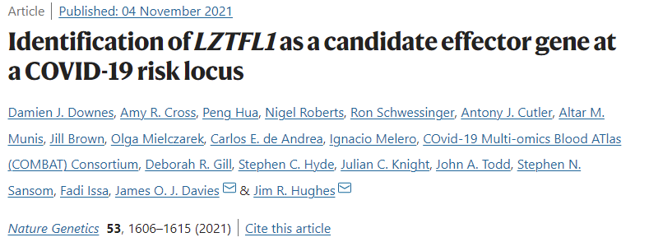
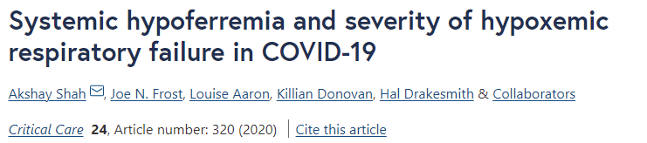
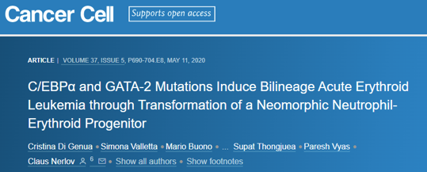
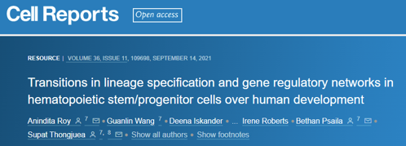
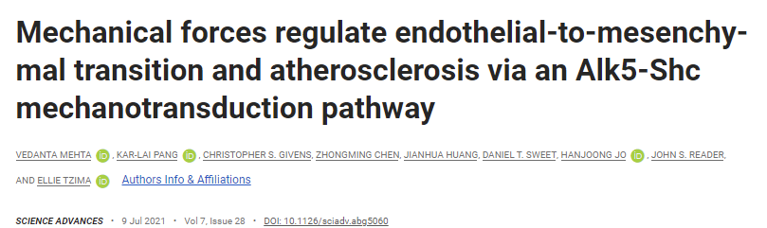
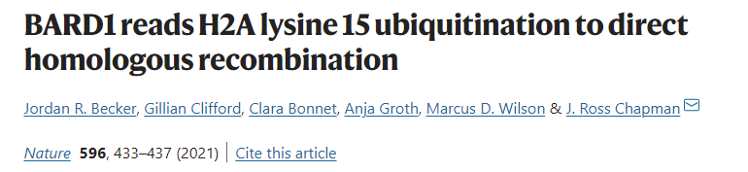
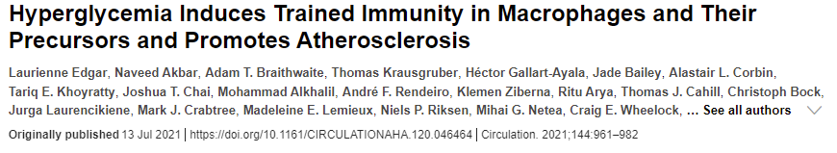
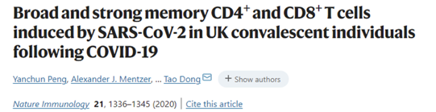
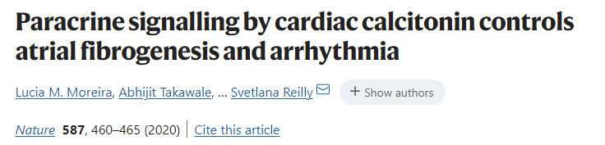
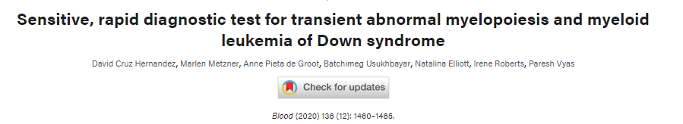
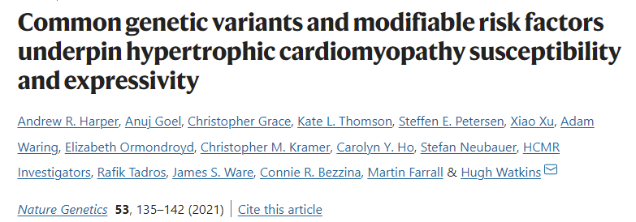
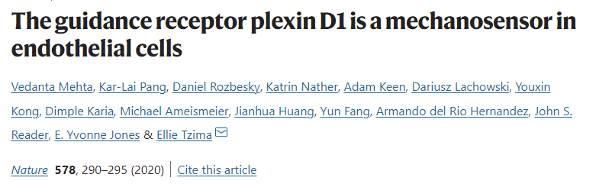
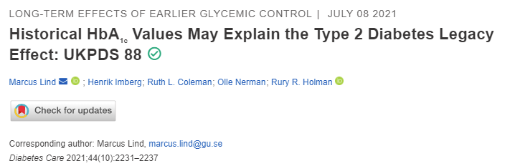
Publications from RDM (>700 per year)

Slide 6
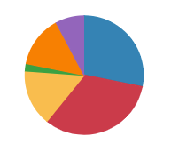
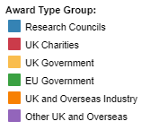
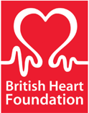



RDM Funding
£200 million – current grant portfolio
£59.1 million – total turnover in 2020/21 (of which £40.4 million was research)
MRC, BHF, Wellcome – are the biggest funders
110 funders – total number of funders in RDM (25 funders are pharmaceutical/industry)
Research councils – 20 awards made, total £10.7M
£38 million / 152 awards – grants awarded in 2020/21
UK Charities – 51 awards, total £12.5M
UK government – 40 awards, £5.8M
Major Funders
EU government – 5 awards, £750k
UK and overseas industry – 19 awards, £5.4M
Other UK and overseas – 17 awards, £2.9M

Slide 7













13 Spinouts from RDM

Slide 8
Radcliffe Department of Medicine (RDM)
RDM Strategic (RDMS)
Experimental Therapeutics
Division of Cardiovascular Medicine
(CVM)
Investigative Medicine Division
(IMD)
Nuffield Division of Clinical Laboratory Sciences (NDCLS)
Oxford Centre for Diabetes, Endocrinology & Metabolism (NDCLS)
Cardiovascular
Clinical Research
Facility (CCRF)
Oxford Centre for Clinical Magnetic Resonance
Research (OCMR)
MRC Weatherall Institute of Molecular Medicine (WIMM)
Acute Vascular
Imaging Centre (AVIC)
Diabetes Trials Unit
(DTU)
Therapy Acceleration Laboratory (TAL)
Human Immunology Unit (HIU)
Molecular Haematology Unit (MHU)
Oxford Centre for
Haematology (OCH)
Oxford Centre for
Advanced Cell Therapy (OxACT)

Slide 9
What could we do better?
Address our joint purpose, and build on USPs
RDM can help to deliver objectives
RDM should help to set objectives
More thematic approaches
A multi-disciplinary department, located in multiple sites and institutions: cross the boundaries set by historic classifications of disease
Follow biology not taxonomy

Slide 10
What is required do better?
Identify a common purpose:
RDM’s primary purpose is research, and RDMs core mission is to improve health by understand the mechanisms of human disease
RDM’s research strategy should be distinctive, with programmes and platforms that are clear, unique and at scale.
Small research programmes alone, even if numerous, will not drive sufficient critical mass or attract the necessary external funding for growth and expansion.

Slide 11
What is required do better?
A robust funding model
Greater focus, in some areas, on FEC to support research
Diversification
Commercial funding for research and trials
Large scale awards, less sole reliance on project/programme funding
Philanthropy
Be more ‘academically entrepreneurial’

Slide 12
What is required do better?
Security and flexibility in career structures, with clarity and transparent goal setting
Supporting early and mid-career researchers
Clinical and non-clinical
Succession planning
RDM should help to set collective objectives, based on:
‘gains of function’
Capitalise on synergies:
- within and across the department
- with other departments (in MSD and across the University)
- external and international

Slide 13
RDM - Future Areas for Cross-Disciplinary Research
Cardiometabolic Disease, Immunometabolism
Cell & Gene Therapy, Gene Editing & Regenerative Medicine
Cellular Ageing – basic mechanisms in common-age-related diseases
Circadian Biology in common diseases and experimental therapeutics
Use of AI in clinical applications
Biological and metabolic clinical imaging
Clinical Trials capabilities – early phase, stratification, cellular/molecular end points

Slide 14
Experimental Medicine & Trials
Radcliffe Department of Medicine (RDM)
Clinical Imaging
Molecular Medicine
RDM Strategic (RDMS)
Experimental Therapeutics
Cell & Gene Therapy
Division of Cardiovascular Medicine
(CVM)
Investigative Medicine Division
(IMD)
Nuffield Division of Clinical Laboratory Sciences (NDCLS)
Oxford Centre for Diabetes, Endocrinology & Metabolism (NDCLS)
Cardiovascular
Clinical Research
Facility (CCRF)
Oxford Centre for Clinical Magnetic Resonance
Research (OCMR)
MRC Weatherall Institute of Molecular Medicine (WIMM)
Acute Vascular
Imaging Centre (AVIC)
Diabetes Trials Unit
(DTU)
Therapy Acceleration Laboratory (TAL)
Human Immunology Unit (HIU)
Molecular Haematology Unit (MHU)
Oxford Centre for
Haematology (OCH)
Oxford Centre for
Advanced Cell Therapy (OxACT)

Slide 15
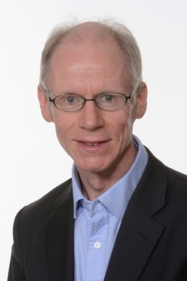
I look forwarding to meeting, and hearing from you
I’ll help to identify and agree our mutual objectives
I’ll listen to what you think could or should change, and what is already excellent
I’ll look at how we best organise our department, to give our leaders the best possible support
I’ll meet with ECRs, regularly and openly, so that I know how to support you
I’ll work closely with the RDM admin teams to ensure that we can deliver our research and teaching effectively

