Slide 1
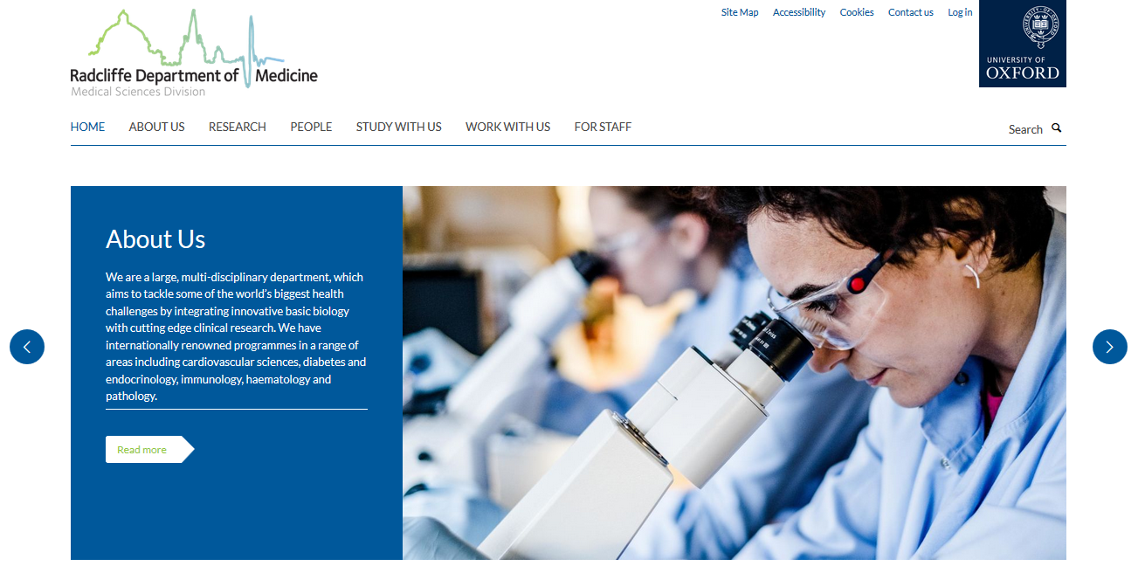
Log in using single sign-on

Slide 2
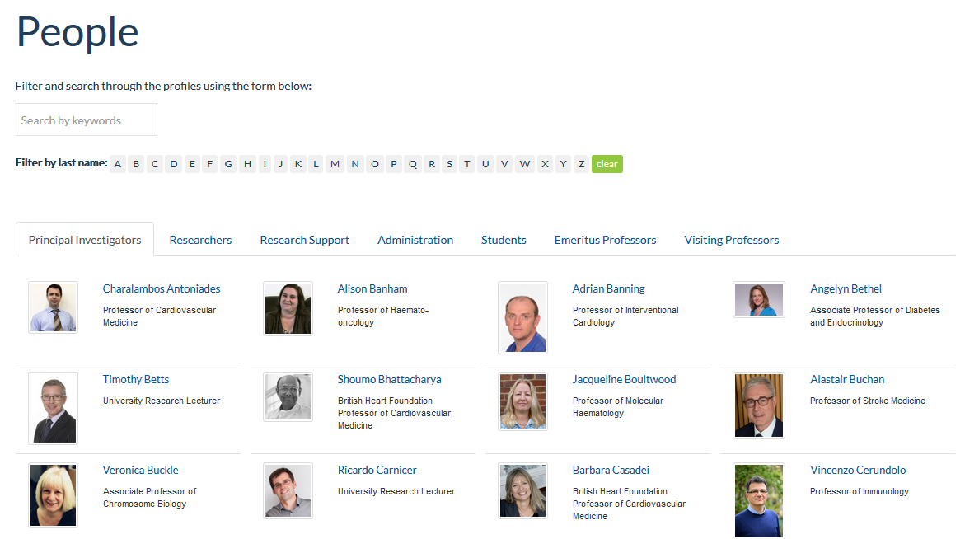

Slide 3
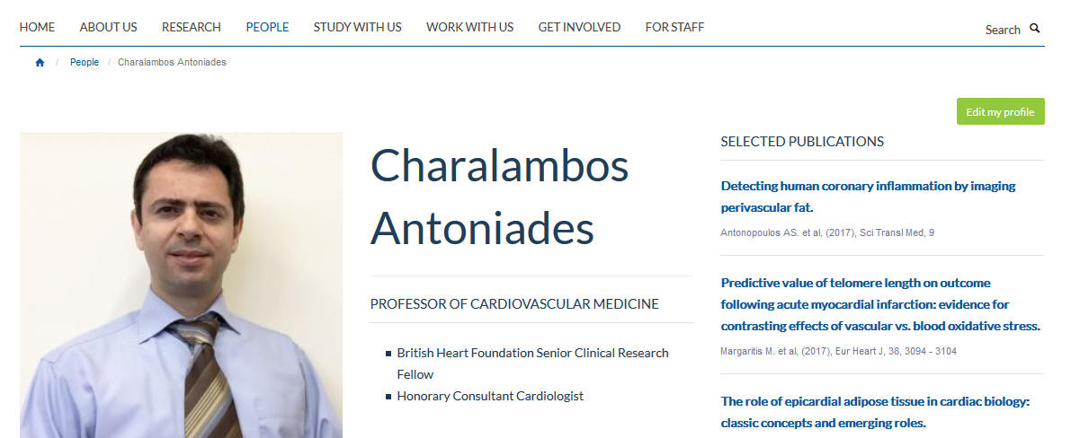
Edit my profile

Slide 4
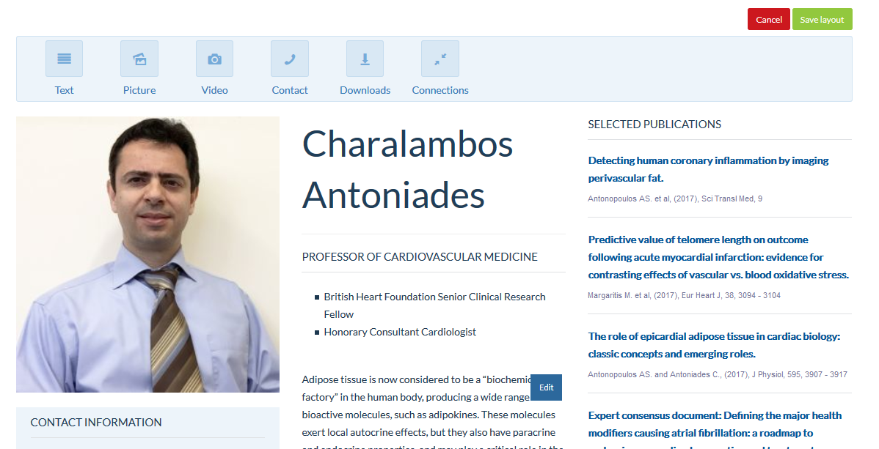
Information is displayed in tiles…

Slide 5
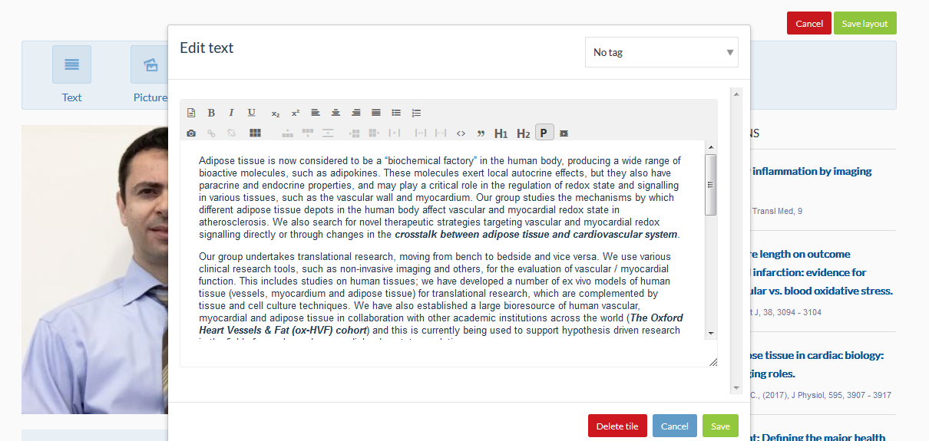

Slide 6
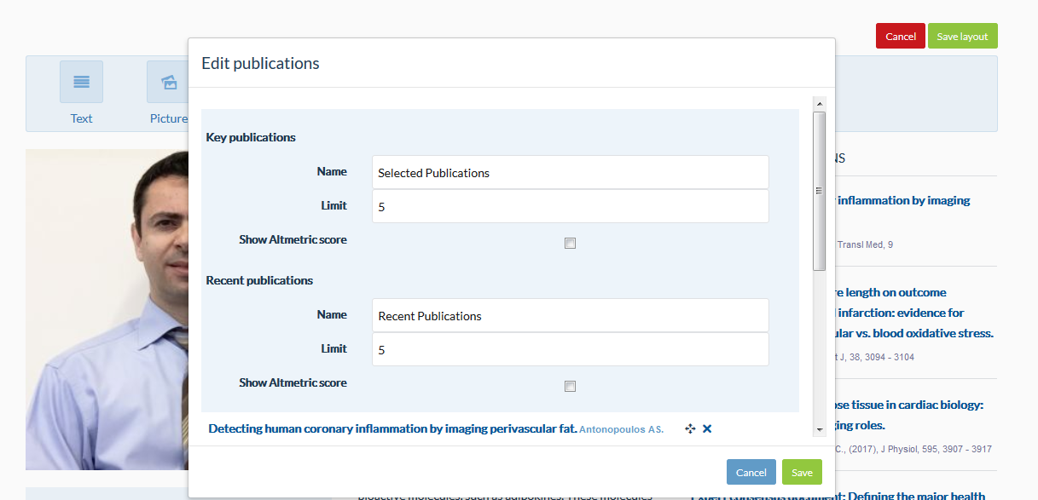
Adding publications

Slide 7
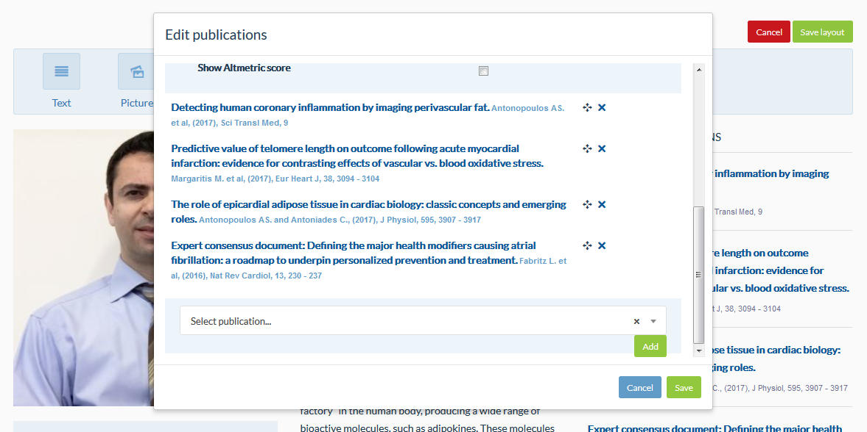

Slide 8
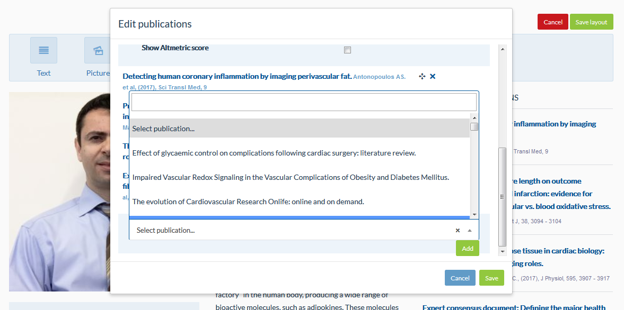

Slide 9
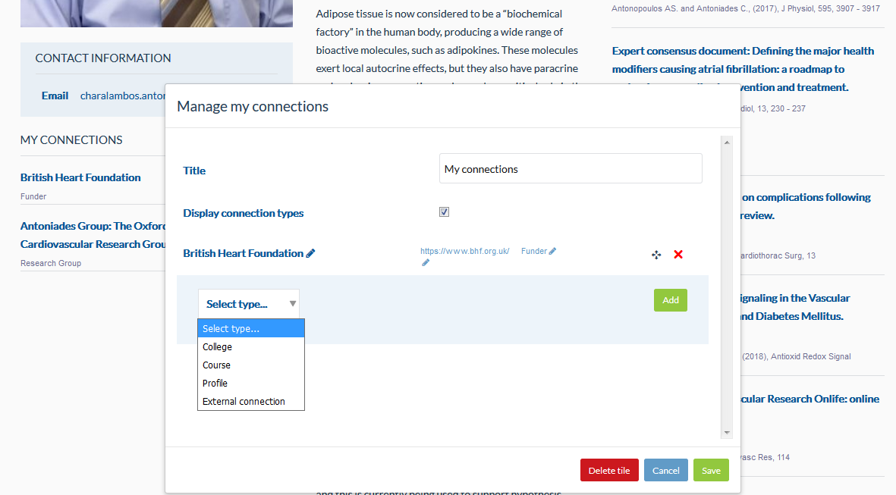
Adding connections…

Slide 10
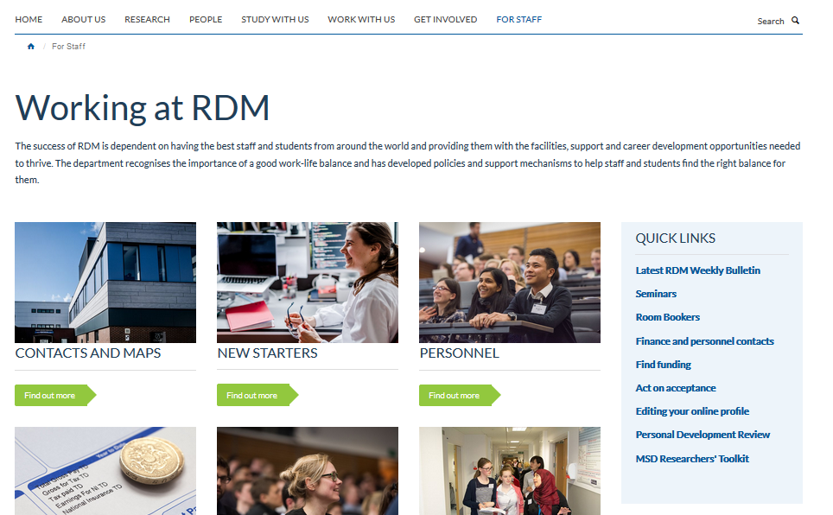
More help…
website@rdm.ox.ac.uk

Slide 11
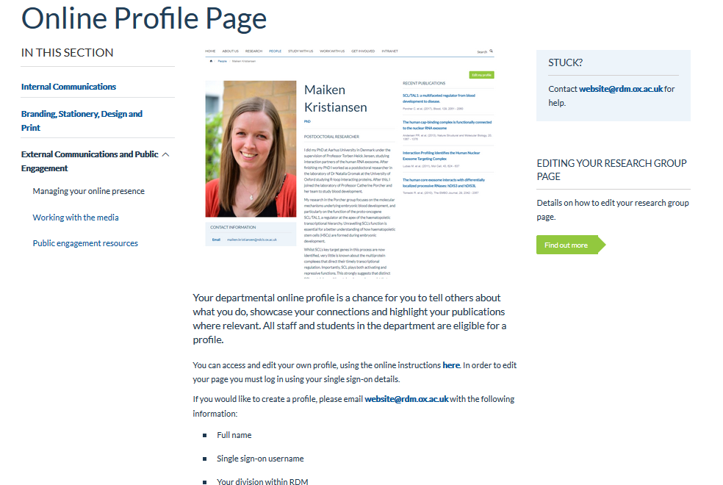
Frequently Asked Questions
Who can edit different parts of the website?
Individuals can edit their own profile pages. PIs can delegate access to PAs/EAs but I will need email confirmation. Research groups can be edited by the PI and delegated individuals – get in touch if you need access.
Lead administrators for each of the divisions can edit other parts of the site, but largely edits are managed by website@rdm.ox.ac.uk
Will profiles also appear on the WIMM site?
Yes, but they ‘live’ on the RDM site so please edit profiles through host department site.
For any questions or support, please contact website@rdm.ox.ac.uk If your query is genuinely urgent, please flag it as such.

