Slide 1


RDM Open Forum
24 February 2026, 2.30-4.00pm, WIMM Seminar Room
For all staff and students in RDM
Hear from senior managers about new initiatives
Ask questions online or in person

Slide 2
Connect, Check, Deposit:
How to ensure your journal articles meet new REF open access requirements
Sarah Ball, Head of Strategic Research Development

Slide 3
Research Excellence Framework (REF) 2029
REF is a periodic exercise that evaluates the quality and impact of research in higher education providers.
The outcome determines the distribution of public funding (about £2 billion /year) for universities’ research
Assessment
  Strategy, People and Research Environment (20%) – institution and unit level evidence statements on strategy, people and research environment
  Contribution to Knowledge and Understanding (55%) – research outputs
  Engagement and Impact (25%) – impact case studies

Slide 4
New REF Open Access Policy
To be included in REF ‘Contribution to Knowledge and Understanding’ assessment, journal article and conference proceedings must meet the REF open access policy
On 1 January 2026, new open access policy for journal articles and conference proceedings came into effect
The main changes are:
  Embargo allowance is now 6 months (Main panels A&B) and 12 months (Main Panel C&D)
  Must be made open access under a Creative Commons (or similar) licence with a preference for CC BY

Slide 5




Simple steps for REF open access
1
CONNECT
Connect your ORCID and enable auto-claiming
in Symplectic Elements, to help identify your articles
One-off action
2A
CHECK
Is your article:
Open access on publisher website immediately after publication?
Under an open licence, e.g. CC BY?
If so, it is REF compliant
If not (or unsure)
2B
DEPOSIT
If in doubt, deposit your article's author-accepted manuscript in ORA as soon as it is accepted (and within 3 months of publication)
This will make sure it is REF compliant
MORE INFO www.bodleian.ox.ac.uk/ref-oa
GOT A QUESTION? openaccess@bodleian.ox.ac.uk

Slide 6

Are you REF ready?
Check the new
OPEN ACCESS REQUIREMENTS
for journal articles
www.bodleian.ox.ac.uk/ref-oa

Slide 7
Prevention and Management of Work-Related Stress: new University policy
Luke Evans, Head of Operations

Slide 8
Safety policy release November 2025
Policy on the Prevention and Management of Work-related Stress
H&S Basics eLearning (10 April 2026)
Fire Safety
Compliance with the Chemical Weapons Act

Slide 9
What is stress?
‘The adverse reaction people have to excessive pressures or other types of demand placed on them.’ (Health and Safety Executive)
Can be short-term or prolonged
Not the same as mental illness, but can lead to mental (and physical) illness if uncontrolled

Slide 10
How we can contribute to prevention
Everyone
Line managers & supervisors
Raise concerns early
Engage in constructive conversations
Act professionally and respectfully
Use available support
Assess the risk to their staff from work-related stress
Identify and implement workplace adjustments where possible
Signpost to resources
Document all actions taken, respecting confidentiality

Slide 11
Resources and support available
Mental Health Awareness eLearning
Mental Health Awareness Training for Line Managers
Confident Manager Series (POD)
Wellness action plans
Employee Assistance Programme (spectrum.life)
Thriving at Oxford
Occupational Health
RDM Wellbeing at Work website

Slide 12
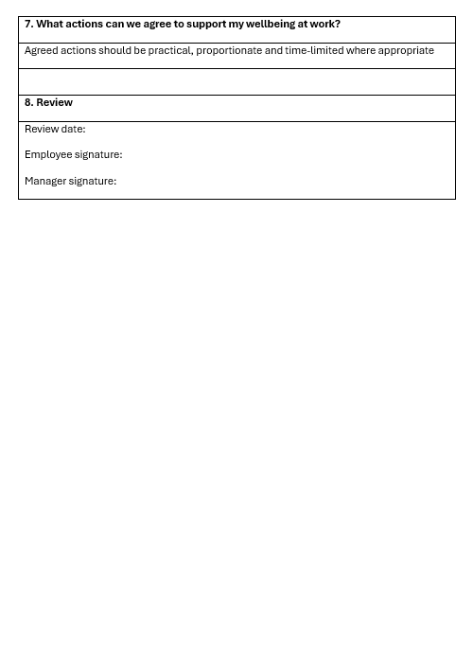
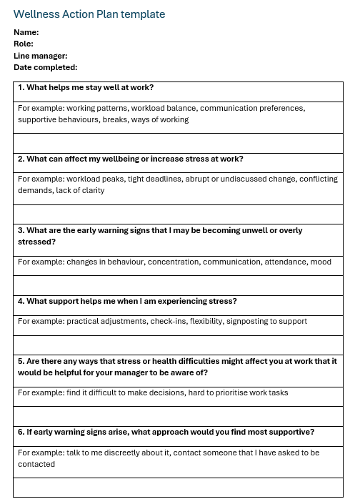
Wellness action plans
Optional tool to support conversations
Preventative measure
Agreed in collaboration with line manager
Focus on practical steps
Confidential

Slide 13
Developing RDM in line with our new Research Strategy 2025-30
Keith Channon, Head of Department
Jane Sherwood, Head of Administration and Finance
Sarah Ball, Head of Strategic Research Development

Slide 14
Reasons for change
Strengths
Gaps
Areas of scientific strength
Infrastructure
Unconnected silos
Infrastructure and facilities
Research services and support
Cross-cutting research themes establishment
Leadership and support
Lack of RDM identity
MRC unit uncertainty
Communication
People
Oxford
Career support and proposition
Funding
Diversity
Collaboration
NHS link
Complex governance and PSS structure
NHS relationship
Lack of clear strategy

Slide 15

Key recommendations from the review
The review panel recommended that we develop strategies in the following areas:
^{Research}
^{Finance}
^{Estates}
^{People}
^{Students}

Slide 16
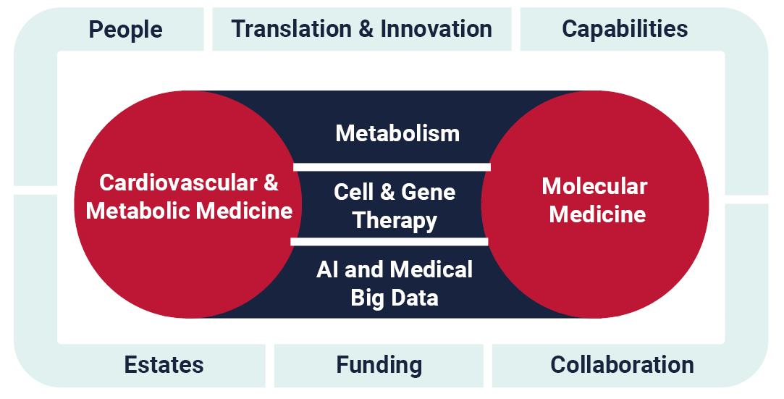
New vision and mission
^{Vision}
To use science to support a healthier, longer life for all
^{Mission}
To improve health through world-leading cross-disciplinary research to understand shared mechanisms of disease and to accelerate the transition from scientific discovery to clinical care

Slide 17
What have we done already?
Set up a new Funding Working Group to increase our income from existing but also new sources, and identify any unnecessary costs we can save.
Begun work on how we can better accommodate the staff and students in the deteriorating OCDEM buildings.
Established 3 cross-cutting research themes and pump priming.
Appointing to our vacant professorial posts (1 filled, 2 recruiting).
Increased academic cross-departmental leadership roles.
Improved career development support (e.g. PDRs)

Slide 18
What are we doing now?
Developing a high-level roadmap for change
Aiming for a simpler departmental structure with improved governance, culture & communication
Addressing RDM’s recurrent financial deficit
Establishing an Organisational Development Steering Group
Undertaking a preliminary round of engagement

Slide 19
What are our next priorities?
^{Engage consultancy support}
Work with the consultants on the project framework
Arrange training in leading and managing organisational development, and change readiness
Produce a resourceable change plan
Consider how to dovetail with the University’s upcoming Professional Services Programme

Slide 20
Communication and consultation
We want to build on the successful model of consultation we used in working on the Research Strategy
We will be taking a phased approach to developing ideas, and consulting with both academic and professional services colleagues
We commit to keeping in touch with RDM colleagues about progress (e.g. via Open Forum, Bulletin, new termly email from the HoD and dedicated web/intranet pages).
Staff wellbeing will be supported via the University’s wide range of tools: https://unioxfordnexus.sharepoint.com/sites/OxIntranet-health-safety-wellbeing/SitePages/topic-home.aspx#wellbeing

Slide 21
Delivering our vision will take time
This will be a long-term, multi-layered project, which we are currently progressing alongside our usual roles.
Our strategy is ambitious, but we can’t make every change at once.
We must prioritise, taking into account financial and capacity constraints, and manage change in a consultative way, without overloading colleagues or disrupting core operations.

Slide 22
Q & A

