Slide 1

RDM’s research strategy
^{Vision}
To use science to support a healthier, longer life for all
^{Mission}
To improve health through world-leading cross-disciplinary research to understand shared mechanisms of disease and to accelerate the transition from scientific discovery to clinical care
Notes:
We have a new research strategy for 2025-2030.
It’s a strategy for growth.

Slide 2
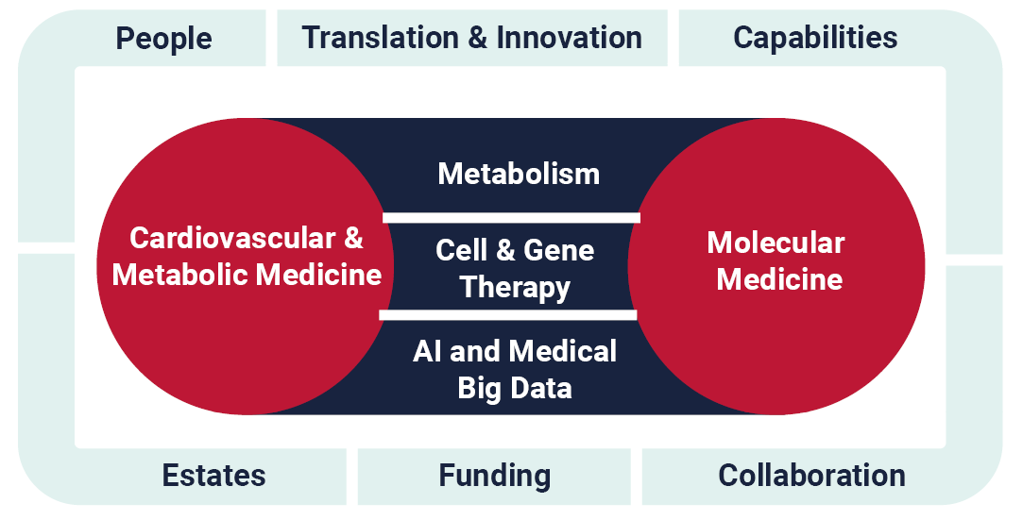
Notes:
This shows how we will organise our research, and what our key enablers are.
One of our key enablers is people, and that is what this Open Forum is going to focus on today.
We’ll start with a presentation about the RDM Mentoring Programme, then we’ll hear about the results of the Staff and Student Surveys, and what actions we’re taking as a result of that. Finally we’ll hear from our Head of HR on our updated anti bullying and harassment resources.

Slide 3
Mentoring
A catalyst for self-development
Manjiri Gokhale Joshi
RDM Mentoring Coordinator

Slide 4


Careers chug along
What can tomorrow bring?

Slide 5

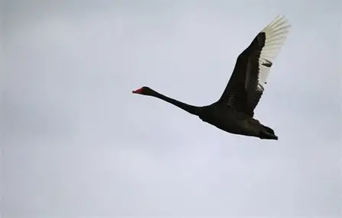
The next few years could bring…
Stagnation
Boredom
Writer’s block
Imposter syndrome
Deadline pressure
Confusion
Personal & professional priorities in conflict
Black swans

Slide 6

Help navigate uncertainties
What mentoring could do…
What mentoring will not do…
Provide specific subject matter expertise
Answer technical questions
Get you a promotion!

Slide 7

Why be a mentor?
Giving back
Sharing experience
Fulfilment of seeing someone else succeed
Satisfaction of helping someone overcome challenges

Slide 8






RDM Mentoring Scheme Overview
Navigate uncertainty
Maximise potential
Monthly meetings recommended
In person and virtual meetings
Career progression
Personal development
Mentors and mentees comprise staff and students
Sign up on Mentornet
Mentees search for mentors

Slide 9
The Mentoring Process
Visit www.rdm.ox.ac.uk/mentoring for more on the programme and find the link to MentorNet
Mentoring Committee approval on matches
Log on to MentorNet
Mentor profile update
Mentee profile update
Request up to 5 mentors
Matches conveyed to mentor-mentee pairs via Mentornet
Mentors and mentees commence meetings
If a mentoring relationship is not working, get in touch and an alternative match will be found. There is no stigma associated with this.

Slide 10
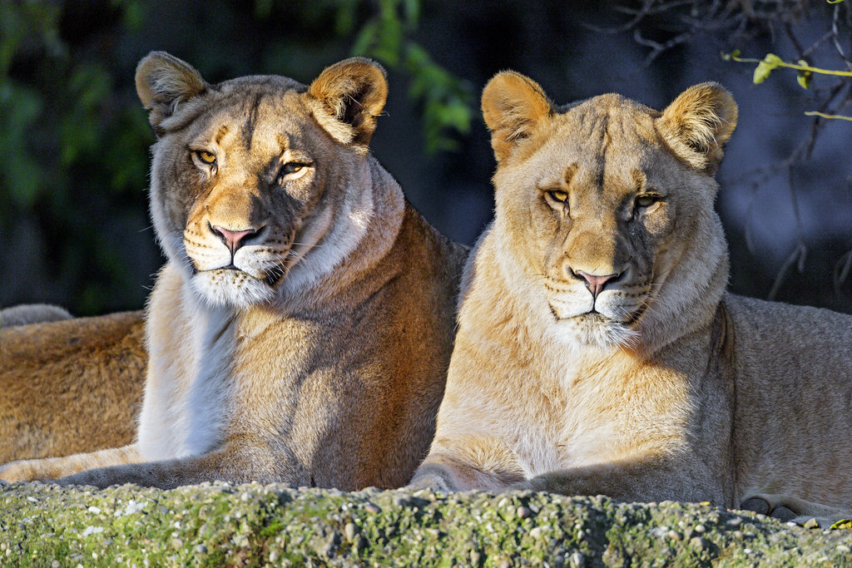
Never give up the opportunity to have a mentor
One is never too experienced or accomplished to benefit from a mentor.
Will you replace your mirror with AI?
https://www.rdm.ox.ac.uk/intranet/career-development/mentoring
Make friends who force you
to level up

Slide 11
RDM Surveys 2025
The story so far and what is coming next
Charlotte Smith
RDM EDI and Strategic Projects Facilitator
Notes:
A overview of what we’ve done with your results so far and how we’ll be continuing to use them…
Two surveys with two different survey methodologies
Staff survey is via People Insight, and run across the whole university which enables comparisons with earlier surveys and MSD/University Data
Student survey is run by MSD with anonymised data provided to RDM in excel.

Slide 12
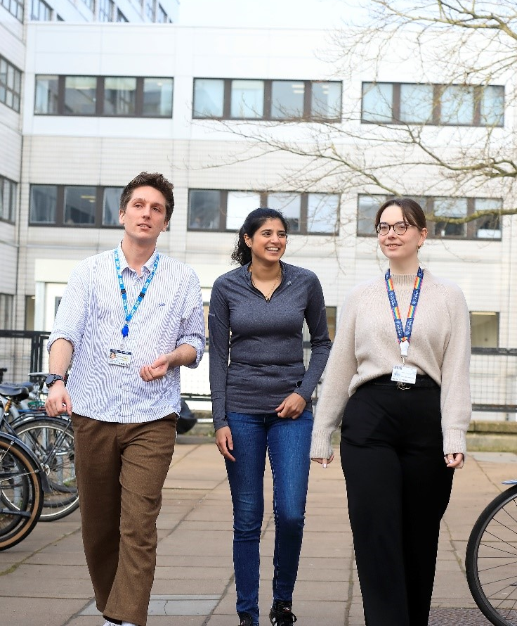
Student Survey - Overview
In 2025, 43 students completed the survey which equates to a response rate of about 24%.
The 2025 survey highlights strong performance in supervision and induction.
Culture and training are generally positive.
Leadership and communication received the lowest ratings, with concerns around transparency and the effectiveness of internal communications.

Slide 13
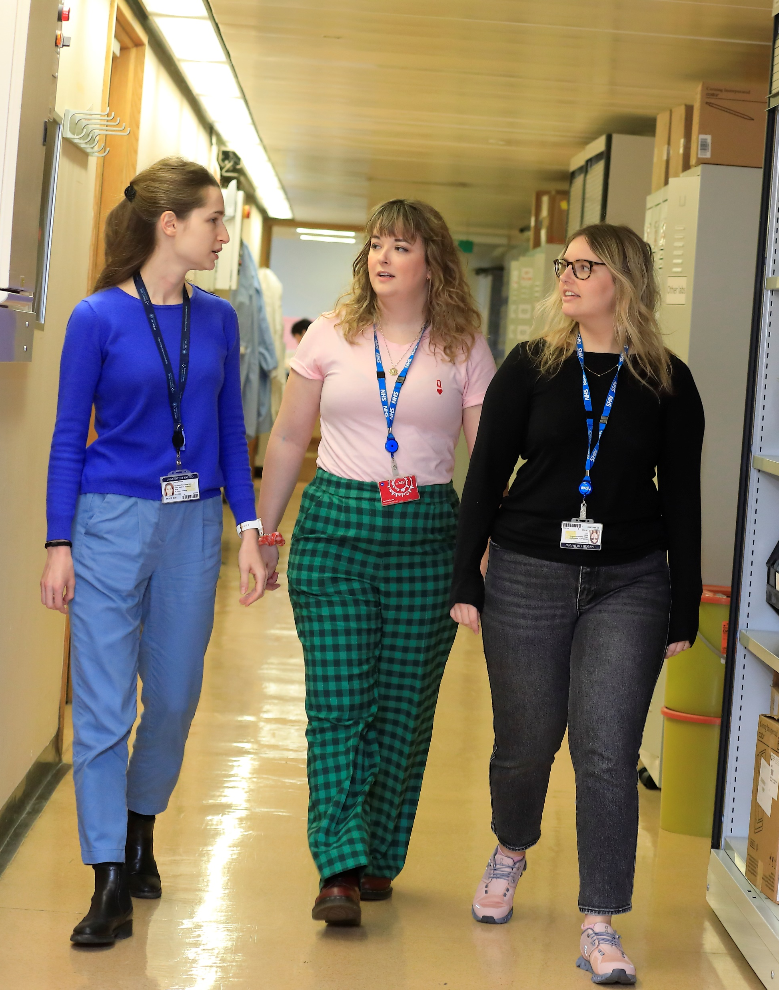
Student Survey – Actions
Actions and responses have been discussed at the RDM Graduate Studies Committee and RDM Student Forum.
Annual reminder to supervisors and students about leave entitlements
Student Buddy System
Student-lead sessions for interview candidates
Annual meetings with local Director of Graduate Studies
Careers services and advice
Notes:
Leave entitlement. Supervisors and students will be reminded annually that they get 10 training days and 30 days annual leave.
Student Buddy System. Student buddies are now selected from an RDM division different from that of the new student, thereby providing a wider view of RDM.
Potential students / those who have applied and been invited to interview are invited to student-lead sessions at which they can ask questions about the interview process, being a student in RDM and at Oxford. Once there is a cohort of existing Masters students, separate sessions will be held for DPhil and Masters candidates.
Annual meetings with local DGS. Local DGSs will discuss progress and any student concerns, whether a Thesis Committee is advised, and if students also acting as Research Assistants are being given enough time to undertake their DPhil research.
Careers services and advice. All students are reminded on an annual basis about the RDM Careers Day and also about the services provided by the University Careers Service and Vitae.

Slide 14
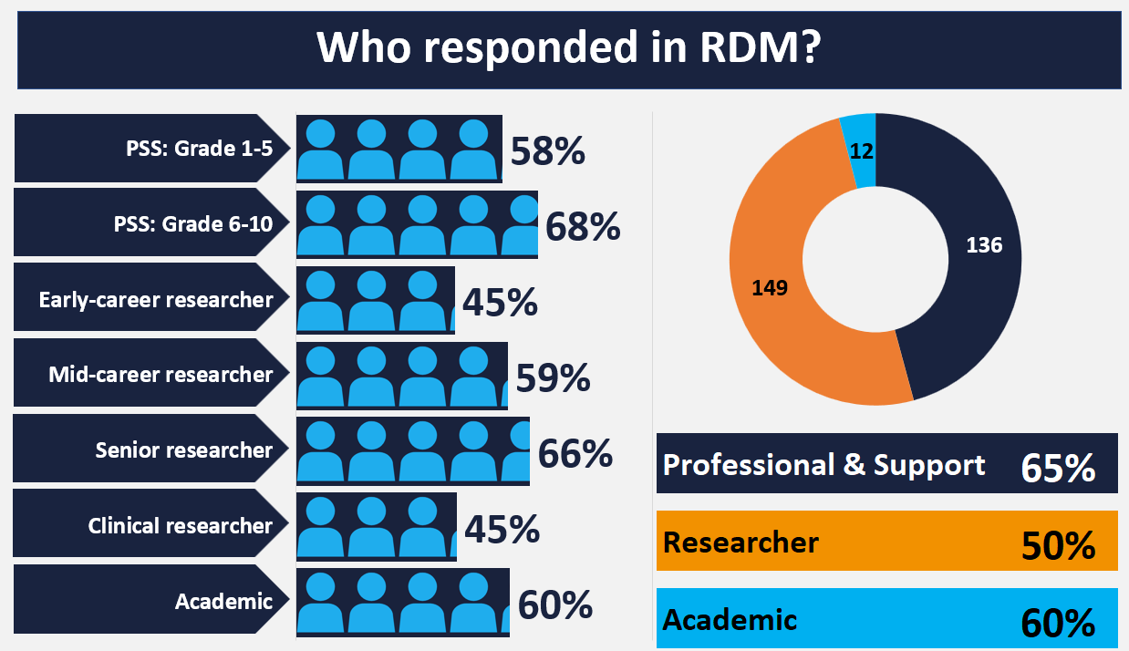
Notes:
All following slides refer to Staff Survey
In total, 297 RDM members of staff responded to the staff survey (56%).
Though this is slightly lower than the University and RDM's 2023 response rates, overall the results give us an good indication of where we have done well and where we need to improve.

Slide 15
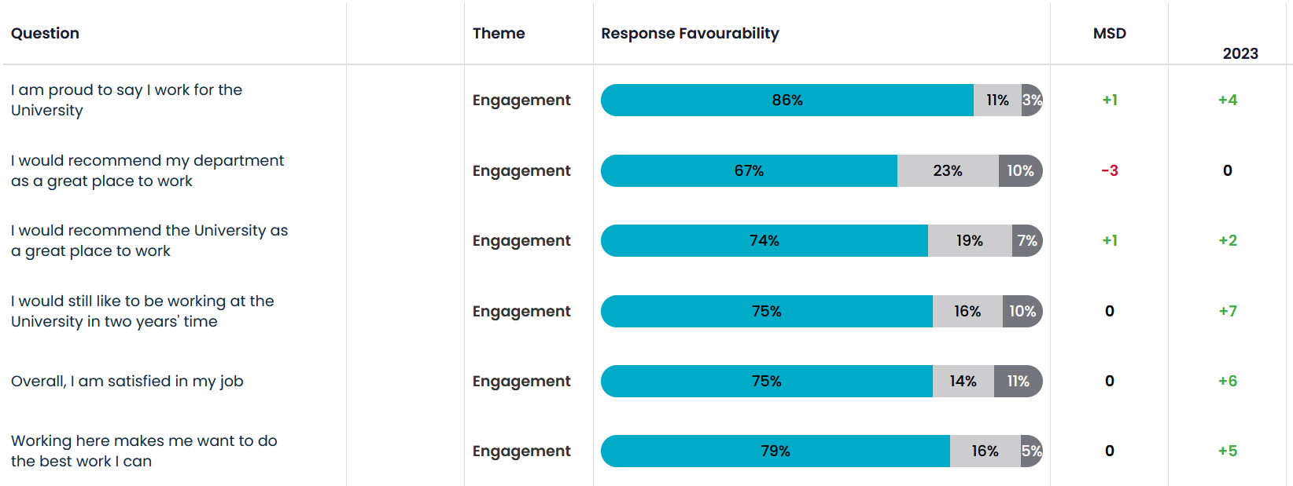
RDM Staff Engagement Questions
Notes:
Engagement is the central measure of the survey, and is measured by respondent’s average response to 6 engagement questions which speak to general satisfaction in their role/department/University:
The comparison here is more specifically against MSD and RDM in 2023 (rather than University which was used in the first slide)
Those in grey represent neutral responses and is where we have the greatest influence (dark blue positive, light blue negative)
The demographic with the widest spread for engagement is Job Role. Support and Technical were the most favourable and Researcher (other), were the least favourable.

Slide 16
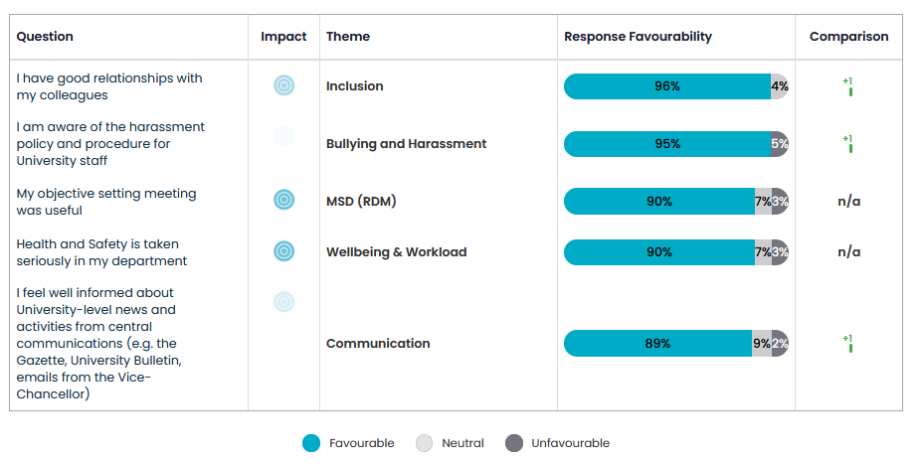
Highest Scoring Questions in 2025

Slide 17
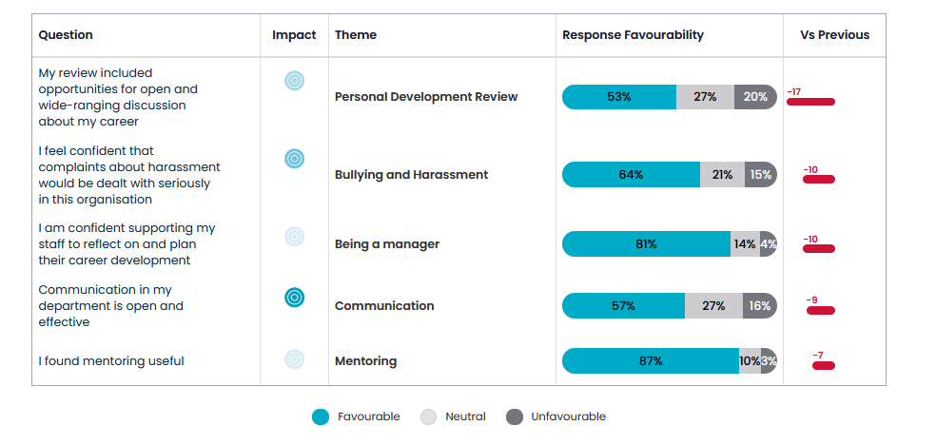
Biggest decreases since 2023
Notes:
We were already aware of many of these and have actions underway
So we’re already working on some of these areas like
The new Career and Professional Development reviews policy and processes, which include 10 days Continuous Professional Development for all RDM staff
Harassment – we have just received new mandatory training module based on the prevention requirements from the Office For Students, coming into force on 1st August.
We have identified more specific actions by … (go onto the next slide)

Slide 18
Identifying actions
Step 1: Review of department-wide survey which revealed 3 priorities across RDM:
Leadership
  Questions included ‘leaders here act as good role models’, ‘my department sets clear expectations of behaviour’
Communication
  Questions included ‘Communication in my department is open and effective’
Transparency, clarity and management
  Questions included ‘Management and decision making is clear in my department’
Step 2: Consultation with Head, Business Manager & EDI Champion in each RDM division:
Discussed results specific to their area
Identified additional specific local actions to add to RDM actions
Notes:
Members of the RDMS team, in particular CS and EE look at the results for RDM as a whole and concluded three key priority areas for future actions.
We should note communication in this context is more typically referring to how we communicate with each other rather than one-way communication outputs (When looking at communication channels, 89% felt well informed about University events and information). (CS Note – can add 57% of respondents feel communication is open and effective, 27% respondents were neutral and 16% responded unfavourably).
Emma and I then met with all the RDM Division Heads, Business Managers and EDI Champions to discuss
RDM Wide Results and actions
Divisional Results and actions

Slide 19
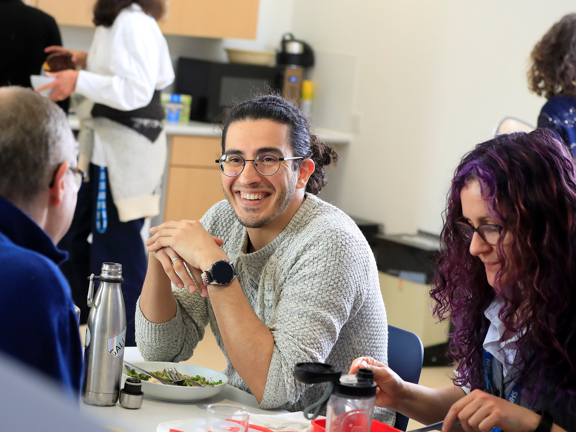
Actions
2025 survey results have already supported the following actions:
Running the People Centred Management Programme
Local delivery of POD’s Leading and Managing People in Research
Continued improvements for PDR/CDR
Increase mentoring resources
Training and support on how to have difficult conversations
Updating RDM Anti-Bullying and Harassment Information
Notes:
You asked for an increase leadership training – two examples above
You asked for Increase career development resources such as Mentoring / PDR / CDR
We’re using your responses to also look at specific issues such as how to increase confidence in holding difficult conversations
You said information about B & H was unclear so we’ve re-designed the RDM webpages which were released last week.
This is just the start, we will be using these survey results to develop further actions.
And also across Oxford the results have real impact (in 2025 10,838 University staff (63%) responded)
Mention the feedback from the 2023 Staff Survey has contributed towards
Pay and Conditions review
Academic Career and Reward framework
Wellbeing / Thriving at Oxford Action Plan
https://edu.admin.ox.ac.uk/your-feedback-in-action-0

Slide 20
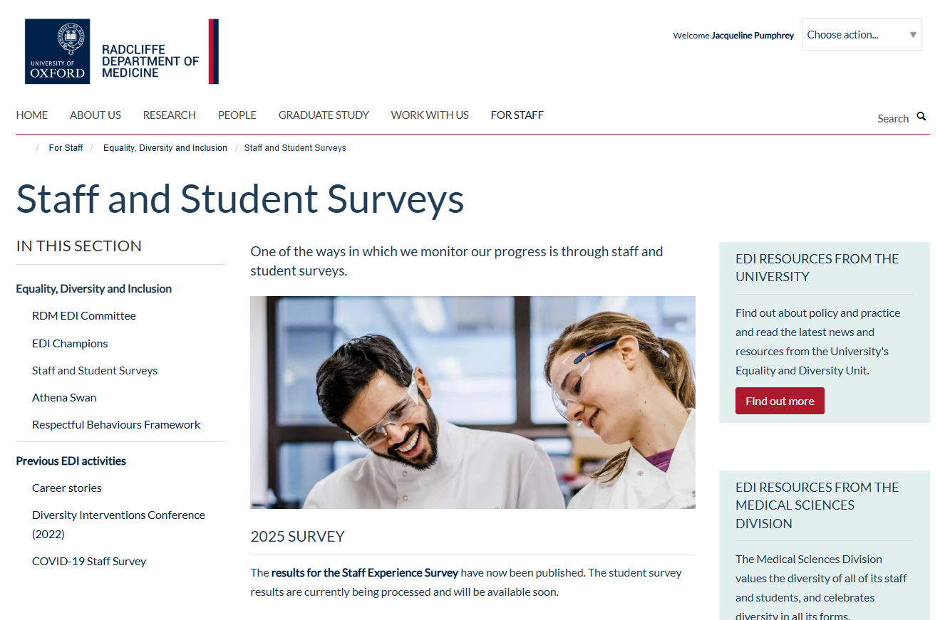
Key next steps
Survey action plan will be discussed by the RDM Senior Leadership Team
Action plan information published on the RDM website
Regular updates and check-ins will be made via the Bulletin
Your survey responses continually influence how we improve the culture and structures across RDM and the University.
Notes:
At the next SLT meeting on 17 November a fuller set of actions and responses will be discussed.
Information about the action plan will be published on the RDM website and announced in the RDM Bulletin following the Senior Leadership Meeting
We will use the Bulletin and other communication channels (such as divisional mailing lists).

Slide 21
Anti Bullying & Harassment
Emma Engel
RDM Head of HR
RDM, in line with the University, fosters an inclusive culture which promotes equality, values diversity and maintains a working, learning and social environment in which the rights and dignity of all its staff and students are respected.
Notes:
Keith:
We are in the middle of changing and potentially stressful times in the University sector and people may be feeling the pressure here in RDM.
We need to focus on building relationships and working together in order to support each other through challenging times.
This presentation is really important as it highlights how we need to respect each other. If people aren’t behaving well towards each other in RDM, they will be challenged on that. I will hold people accountable.
Emma:
Staff survey identified Improvement of the perception of the way in which harassment is taken seriously as an area for focus.
University have updated their training for staff which is required every 3 years called ‘Harassment in Higher Education’ in response to employment legislation on ‘Prevention of sexual harassment in the workplace’ and Office for Student Condition E6 on Prevention of Harassment and sexual harassment against students.
As well as RDM Head of HR taking part in a working group to develop further management training on this important topic we have also displayed information on our website focussing on different scenarios with suggestions of how to respond. Split into 3 areas: what to do if -
You witness bullying / harassing behaviours.
Someone tells you they are being bullied or harassed
Before that we’ll look in a little more detail about whey bullying and harassment might happen

Slide 22
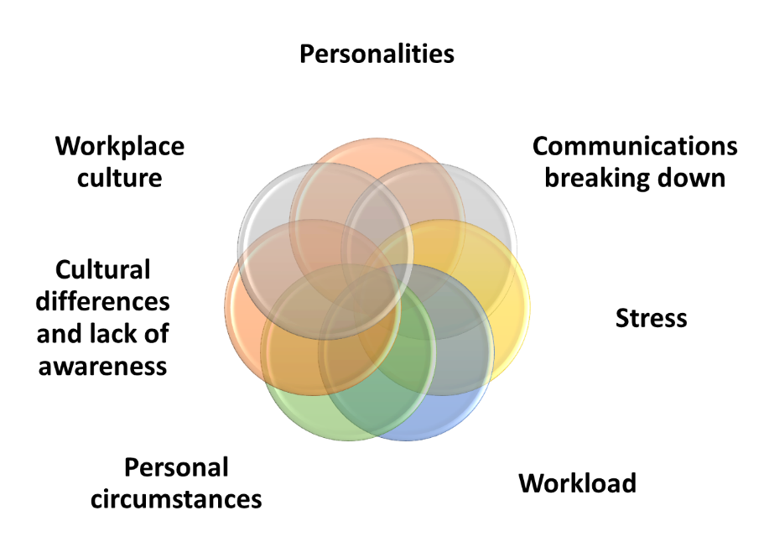
Why does bullying and harassment happen?
Notes:
If you are feeling stressed/unwell/misunderstood do speak to your line manager and or other sources of support like you GP, our Employee Assistance Programme – Spectrum Life. You are always responsible for your behaviour so it is important to let people know if you are having difficulties and use resources to help manage it. That said we all need to look out for each other as sometimes people are not aware that they are stressed and/or that it is affecting their behaviour. If that is the case asking someone how they are doing and letting them know (gently) that they don’t seem to be themselves recently and asking what support they might need is a good starting point. We’ll come on to RDM’s Respectful Behaviour Framework later which will help you have more focussed conversations if needed.

Slide 23
What are the impacts of bullying and harassment?
Individual – reduced engagement, loss of motivation, loss of confidence, increased absence, reduced sleep, increased risk of anxiety/depression
Team – team motivation, additional work, fear/concern, turnover
Department – productivity, culture, attraction and retention, potential loss of research income
Institution – at risk of costly employment tribunals, reputational damage
Notes:
Problematic behaviour in the workplace leads to lots of negative outcomes that affect everyone including the perpetrator. Some that are less well known include the need to report formal (allegations) of bullying and harassment to funders which may affect funding. In a different workplace I have had it said that employment tribunals are ‘the organisations’ problem however claims for harassment can be against named individuals, create a huge amount of work/stress for all involved, are open courts and full judgements (including individual names) are available on the internet to all. Furthermore, because Oxford University’s standing the press are particularly interested in matters related to it.
In RDM we want to do all we can to support individuals both that are feeling bullied and harassed and those accused of it (which can also be very difficult and not always accurate). We have harassment advisors that individuals can speak to (as well as EAP etc as previously mentioned). As a result of the staff survey we have also reformatted website to signpost what to do and resources more effectively which are as follows in the next 3 slides.

Slide 24
What can I do if I experience bullying and harassment?
Is this something I can deal with myself?
Do I need to speak to someone?
Do I want to take things forward informally?
Do I want to make a formal compliant?
Notes:
As a recipient of bullying or harassing behaviour what you should you do?
Firstly, every case will be utterly individual, so unfortunately there is no single answer so…
Give yourself some time to think about your desired outcome.
Consider each of the actions on the slide here…
And know this, that to stop the behaviour it is likely that you will need to take some action, HOWEVER
there is help out there, and there are lots of people and resources who want to help you.
Look for these resources on the RDM Anti-bullying and Harassment pages. And look on
the University website, which includes a single page with multiple resources available.
You can speak to a harassment advisor without any formal process being triggered.
If possible, try to address issues as early as you can…, but it is never too late to talk to someone…

Slide 25
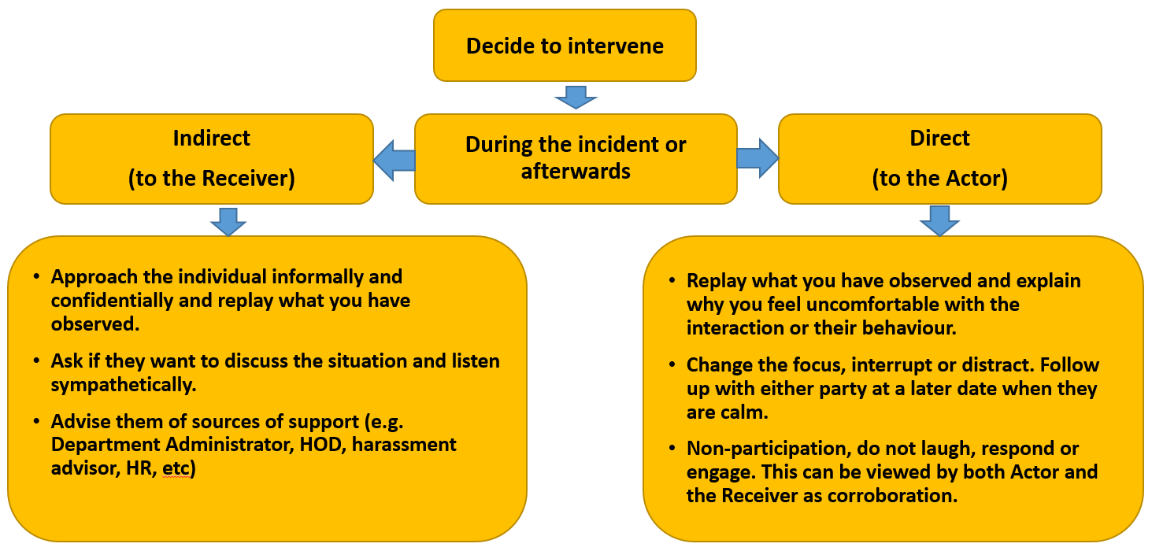
What should I do if I witness bullying and harassment?
Notes:
Broadly speaking there are five types of intervention an individual can take when they are a bystander to inappropriate behaviour
Direct: If you feel able, you can address the behaviour with the actor.
Distract: Interrupt or change the focus to defuse the situation.
Delegate: Get help from someone in a position to intervene, perhaps a member of staff, a colleague or if needed perhaps security.
Document: Record what you see (e.g. notes, video) if safe, to support the person later.
Delay: Check in with the person afterwards, offer support, and let them know they’re not alone.
You may need to use more than one intervention, depending on the situation.
Learn more about being a responsible bystander

Slide 26
What should I do if some reports bullying and harassment to me?
Listen without judgement
Be clear about the limits of confidentiality (safety/legal)
Suggest further sources of support
Outline formal/informal processes
Follow up with them
Notes:
Listen to them, offer support, try to never leave them feeling alone, and seek help / explain the options to them.
Regarding confidentiality, try not to make a promise that you may then need to break. There are a couple of reasons why this may happen if you feel that there is the risk of serious harm. In this instance you need to call for help.
If you think you may need to disclose some aspect of the conversation at a later date (e.g. as part of investigation) although you can make it clear although you may need to do this that you would let them know this in advance.

Slide 27
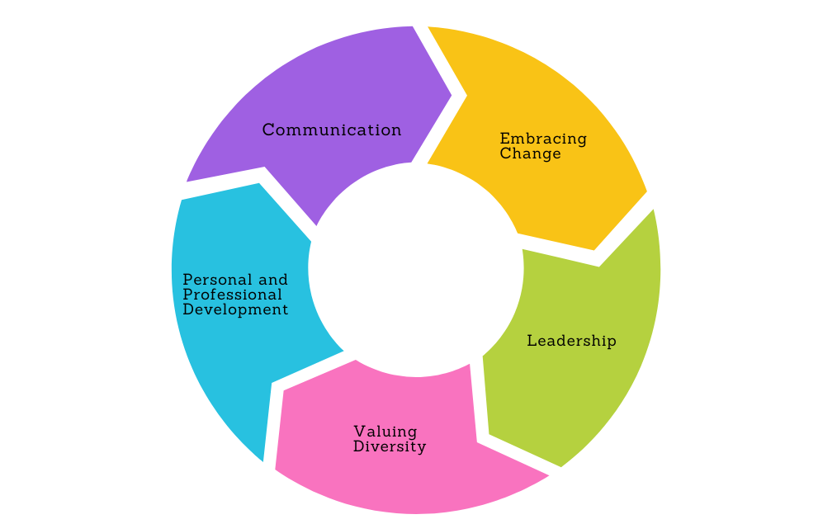
What do we strive for in RDM?
Respectful Behaviours Framework
Notes:
The RDM Respectful Behaviours Framework shows what positive, supportive behaviour looks like in practice.
It works alongside anti-bullying and harassment policies by helping everyone recognise the difference between respectful interaction and behaviour that causes harm.
It covers five key themes.
It can be used by individuals and teams to determine where behaviour might fall, why they are finding it difficult and what a better way of doing/saying things might be and also to share with others to demonstrate what they are currently saying or doing and showing a better way of behaving/how to say things differently.
Anti-Bullying and Harassment — Radcliffe Department of Medicine
Further training in development for managers both on receiving and dealing with complaints of harassment and also creating a positive working environment.

Slide 28
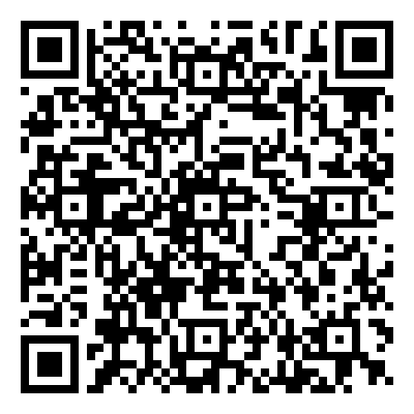
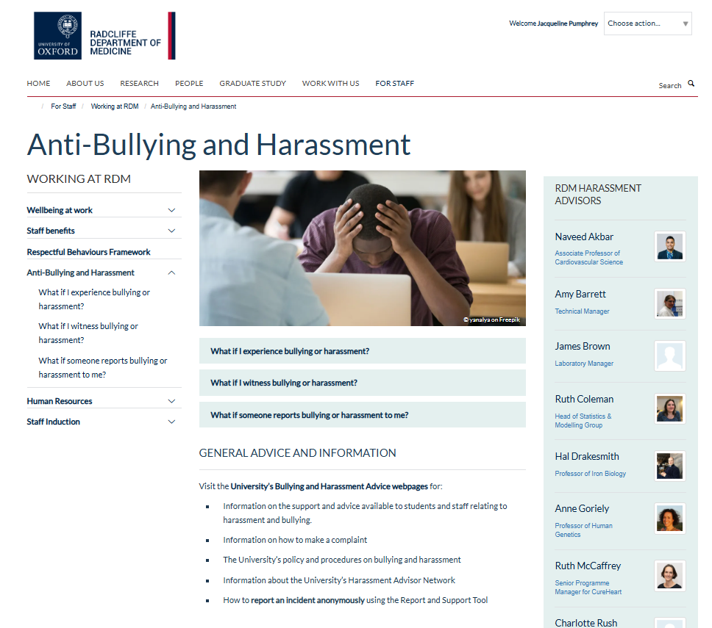
Sources of Support
www.rdm.ox.ac.uk/intranet/working-at-rdm/anti-bullying-and-harassment
Notes:
If you have been subject to bullying/harassment or have been accused of it can be distressing. Support can be found from any of these sources – please reach out if this presentation has ‘triggered’ something for you
Harassment Advisor Network | Equality and Diversity Unit
Anti-Bullying and Harassment — Radcliffe Department of Medicine
Supporting Students at Oxford: Preventing and Responding to Harassment and Sexual Misconduct | University of Oxford
Spectrum.Life – employee assistance programme
Divisional HR Contacts — Radcliffe Department of Medicine
MSD Mediation Service — University of Oxford, Medical Sciences Division
Research Funder Policies and Requirements on Bullying and Harassment | Equality and Diversity Unit

