Slide 1
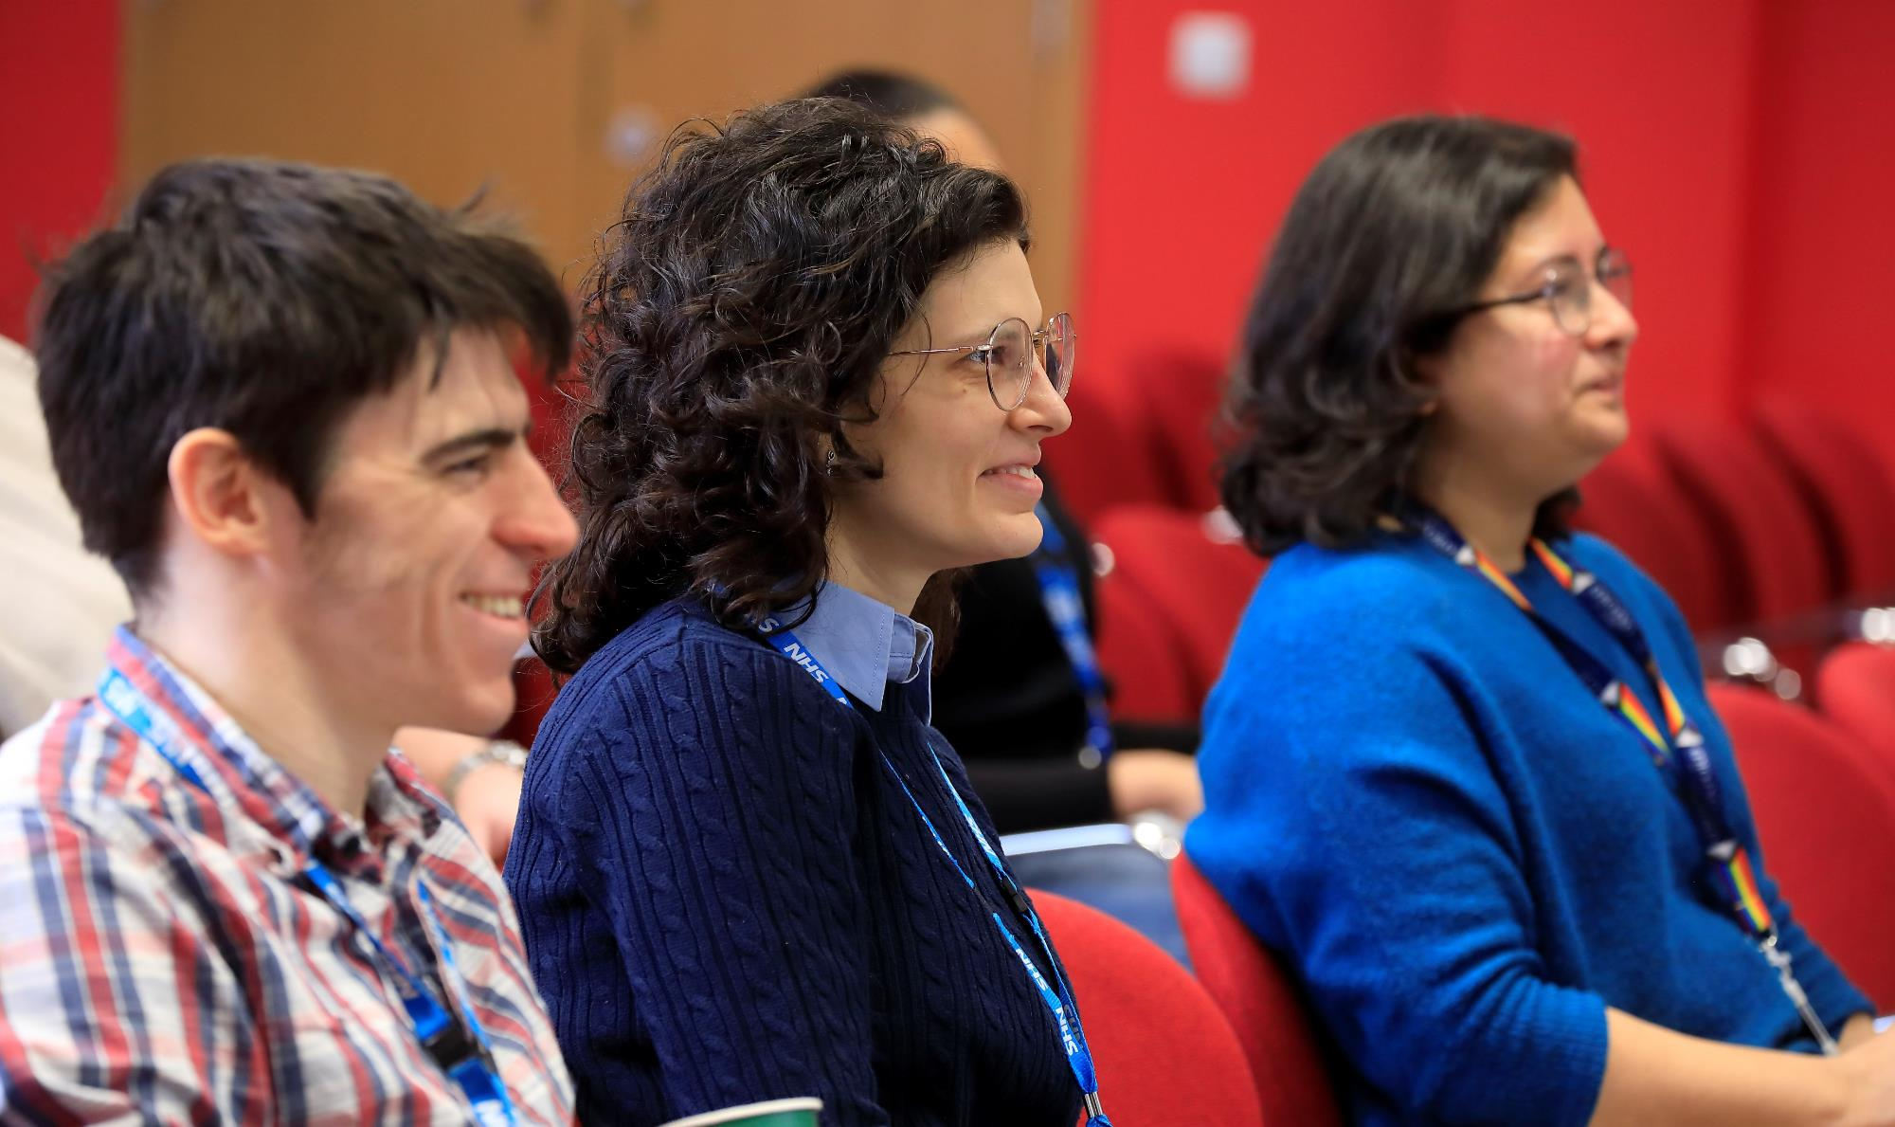
RDM Open Forum
2 June 2025, 12.00-1.30pm, WIMM Seminar Room
For all staff and students in RDM
Hear from senior managers about new initiatives
Ask questions online or in person

Slide 2
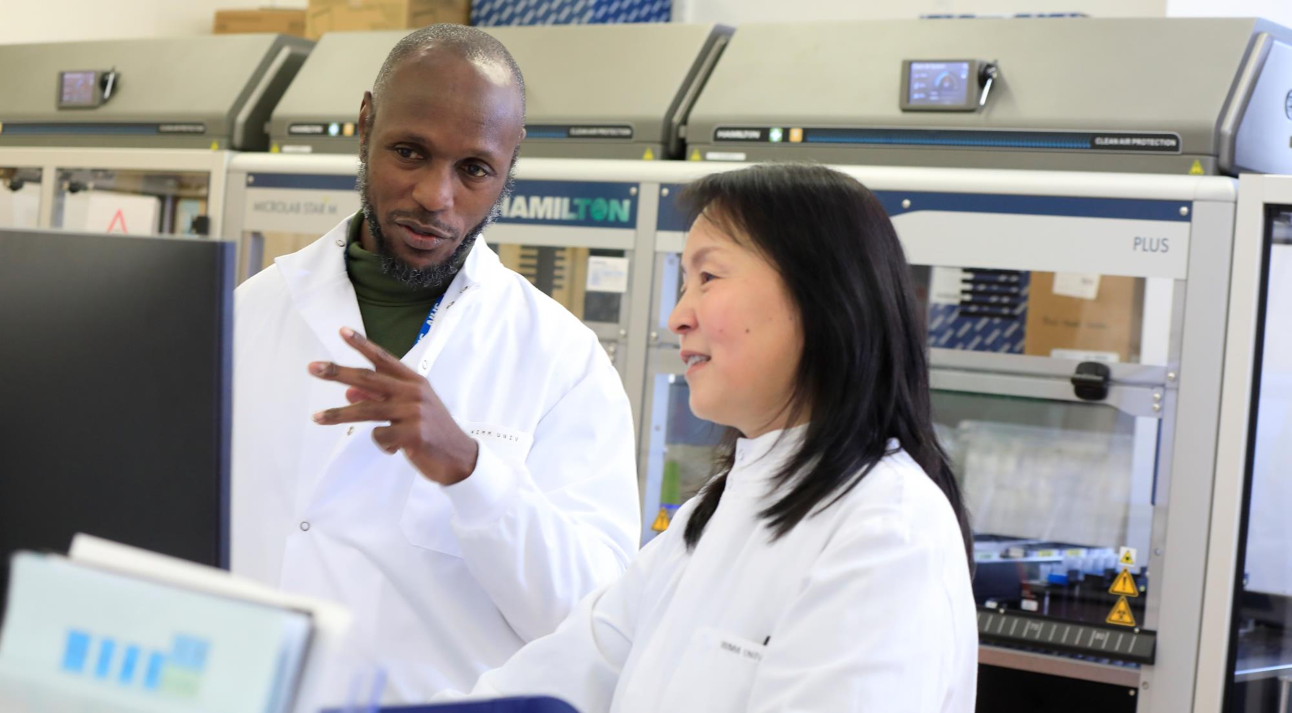

Update on RDM’s New Research Strategy
Keith Channon

Slide 3


The first iteration of the strategy in 2024
Vision: Use science to support a healthier longer life for all.
Mission: Improve health through cross-disciplinary research to understand shared mechanisms of disease and to accelerate the transition from scientific discovery to clinical care.
Metabolism
Cardiovascular and Metabolic Medicine
AI and Machine Learning
Molecular Medicine
Cell and Gene Therapy

Slide 4
Developing the RDM research strategy in more detail
What are our aspirations?
What are the large scientific questions that the department should be seeking to answer over the next 5-10 years?
What will we do?
What are the high-level actions/activities that teams and units will take to answer these questions?
What support is needed?
What needs does RDM need to provide to enable this work
e.g., skills, equipment, partnerships etc.?

Slide 5





Summary of initial working group discussions
Cardiovascular & metabolic medicine
Molecular medicine
Understand the mechanisms of health and disease in all tissues relevant to cardiovascular, neurovascular and metabolic diseases to advance the diagnosis, prevention and treatment
Understand the underlying mechanisms of immune and blood disorders and identify new tests, targets, technologies and therapies to treat these and other diseases.
Tissue
Cells
How do stem cells produce blood and immune cells throughout life and how does this alter in disease and how can patient outcomes be improved?
How does the immune system protect tissues and barrier surfaces throughout life, how does inflammation cause tissue damage and how can we harness immunity for precision medicine approaches?
How can we develop new cell and gene therapies, including in vivo delivery strategies, improved methods of genome editing and cell specific targeting?
How can we accelerate molecular medicine research and translation?
What are the shared mechanisms that drive multi-morbid cardiometabolic disease?
How can innovative methods such as advanced imaging and AI drive insight into cardio-metabolic disease and patient outcomes?
How do modifiable risk factors influence cardio-metabolic disease and its development?
How can we improve the translation of our discoveries into clinical care
Translation
Treatment
Metabolism
Molecules
Notes:
.

Slide 6
Next steps
  May
  Initial workshops held for each priority area
  Proposals tested with SLT and shared with working group members for comment
  June
  RDM Open Forum
  Second round of workshops with working groups
  Test updated proposals with senior staff
  July
  Submit updated research strategy draft to RDM Senior Leadership Team for review and approval

Slide 7
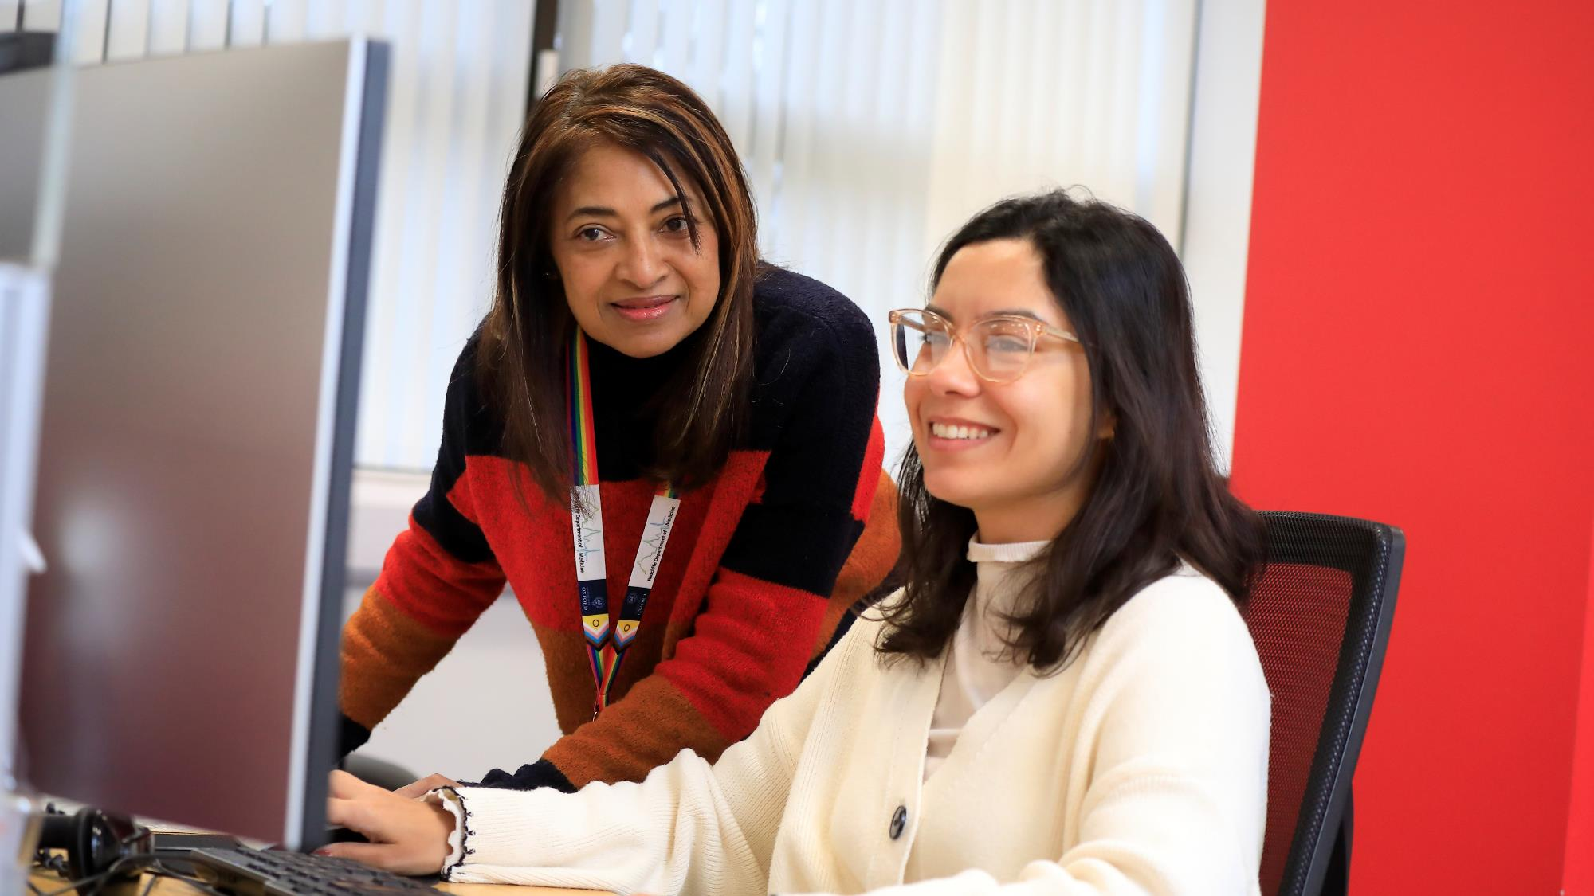
Demystifying RDM’s finances
Eleanor Cameron, Finance Manager

Slide 8
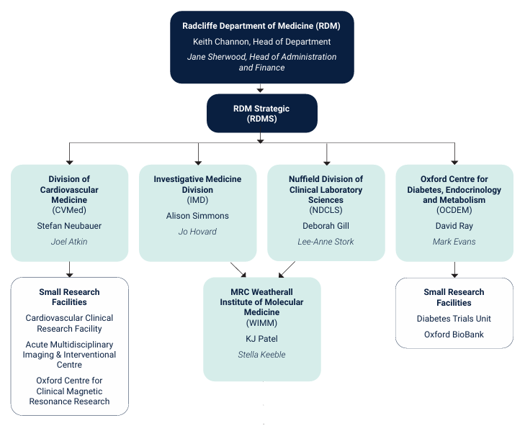

RDM structure

Slide 9
RDM finances 2023/2024
RDM income (total £68.9m)
RDM expenditure (total £68.8m)

Slide 10
How do we bring in research income?
2023/2024 research income in RDM:
£47m research income from external grant funders including £8m contribution to overheads
£11m JRAM income from:
  REF funding
  Charity QR (19%) and business QR (20%)
  a small amount of teaching income

Slide 11
Costs RDM pays to MSD & University
As well as payroll, premises, equipment, research consumables
Cross-RDM support
£1.5m in 23/24
University
Infrastructure charges driven by use, £5.9m in 23/24
MSD Office
Charges driven by departmental income, £1.2m in 23/24
MSD inter-departmental transfers
Charges levied on surplus-making depts to cover deficits made by other MSD depts and BMS, £1.3m in 23/24

Slide 12
Benefits of support RDM pays for
University
Research Services, HR, IT, Legal Services, Estates, Development Office, central Finance, Academic Administrative Division, GLAM (libraries, gardens, libraries museums)
MSD inter-departmental transfers
Deficits covered by surplus- making departments (RDM expected to benefit from this in 24/25 & 25/26)
Cross-departmental support
Cross-cutting research themes (from reserves, limited access governed by MSD & University)
Graduate scholars’ stipends and fees, supervision fees
RDM Strategic support
Training and development events e.g. RDM Day
RDM website
MSD Office
Leadership
Relationships with major partners
Research support
Funding schemes
School of Medicine
Medical Sciences Teaching Centre
RDM

Slide 13
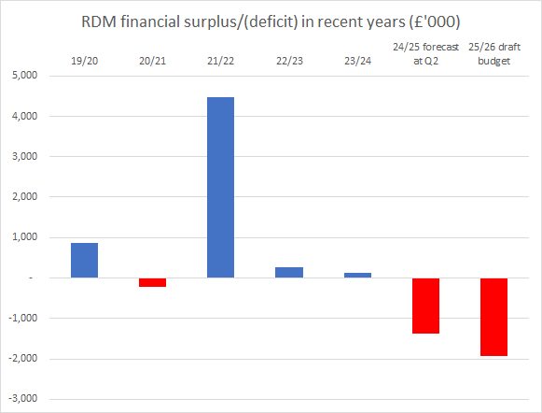
RDM financial outlook is a call to action
Increased income from completed AMIIC cath lab refurbishment after a year’s closure
Increasing financial challenges e.g. inflation in salary costs and utilities
Changes to major, longstanding funding support with ending of two MRC Units in the WIMM in 2027 & 2028
Reducing charity and business QR % rates which top up charity & industry grant funding
Very limited access to historic reserves, largely now lost following major changes to university budget method since 2023-24 (‘Finance White Paper’)
Context within MSD, the wider University and HE sector

Slide 14
The call to action for us all
Diversify our funding portfolio, mainly through increasing applications for industry (120% FEC) and UKRI grants (80% FEC) bringing in higher overhead rates
Increase work with the Development & Alumni Engagement Office (DAE) to seek more philanthropic support
Ensure that overhead bearing grants are being spent – we don’t get the overheads until we spend on the items in the grant
Create robust business plans for new investment, & realistic, clear financial modelling
Use our space efficiently and cost-effectively, so we work in space in better condition & in the right place for the science

Slide 15
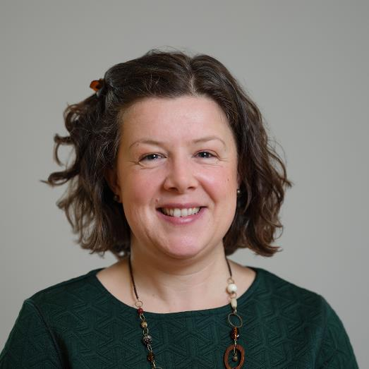
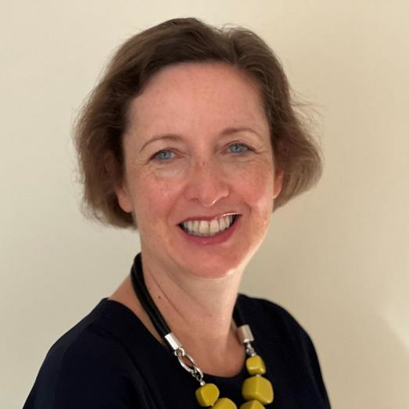
Any questions?
Is there more you’d like to know about RDM’s finances? Contact us:
Eleanor Cameron
RDM Finance Manager
eleanor.cameron@rdm.ox.ac.uk
Jane Sherwood
RDM Head of Administration and Finance
jane.sherwood@rdm.ox.ac.uk

Slide 16

Continuous Professional Development (CPD)
Emma Engel, Head of HR

Slide 17
All staff in RDM are encouraged to take up to 10 days of professional development a year
https://www.rdm.ox.ac.uk/intranet/career-development/development-and-training/professional-development-annual-allowance

Slide 18
Why is CPD important?
  In our sector there is an increasing focus on strengthening and diversifying employees’ competencies, improving career prospects and growing capacity within the research ecosystem
Those who continue to develop across a range of areas are best placed to do world-leading research, seek creative impact pathways and make confident career moves
Dedicating time to professional development deepens and expands your professional skill set in order to enhance your current role, equip you for the next one and broaden your career horizons

Slide 19
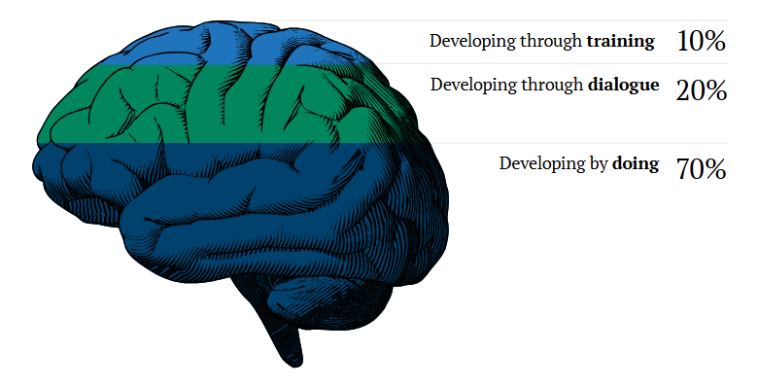
How do we learn?
Reference: Incorporated, L.L., Lombardo, M.M. and Eichinger, R.W. (2000) Career Architect Development Planner book: An Expert System Offering 95 Research-Based and Experience Tested Development and Coaching Tips.

Slide 20
CPD activity types and examples
Develop by doing
Join a working group or a committee within your department/faculty or division
Organise seminars, conferences or networking events​
Shadow a colleague at work​
Take on an informal supervision of a student or colleague for a short period of time
Researcher specific
Contribute to peer-review in journals and funding bodies
Participate in Public and Policy Engagement activities
Develop through dialogue
Arrange a conversation with a person who has a role or career that interests you
Engage in one-to-one coaching -sign up to Oxford's Coaching Network
Join and contribute to networks
Participate in a mentoring scheme, as a mentee or mentor
Researcher specific
Contribute to a conference, seek feedback on your presentation and make the most of networking opportunities
Consult with a Careers Adviser for Researchers​ at Oxford's Careers Service
Develop through training
Attend a workshop or programme delivered by the University or the Divisions
Attend training delivered by an external provider
Attend a workshop from experts in your field of interest
Update your professional employability skills using platforms such as inrehearsal or Massive Open Online Course and others

Slide 21
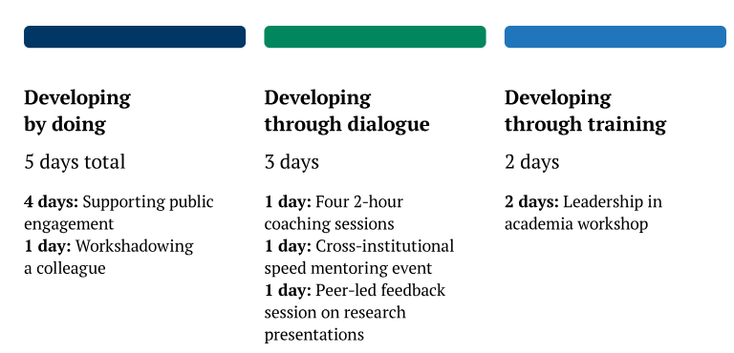
What might a CPD plan look like?

Slide 22
The nuts and bolts of CPD
The Professional Development Review (PDR) season in May to July is a good time to make a CPD plan
You can record your CPD using the HR system, PeopleXD: https://staff.admin.ox.ac.uk/how-guide-employee-self-service-record-professional-development#collapse5071066

Slide 23
Activity: Continuous professional development planning
Find 2 people you don’t know, with different coloured stickers to yours
  Green will be the facilitator
  Red will be the person who wants to prepare a CPD plan
  Blue will be the observer who will provide feedback
Each group take a pack which includes: a pen, questions for the facilitator, a CPD plan framework and hints and tips
Take 5 minutes to read through the handout and prepare
Spend up to 10 minutes having a conversation (using the suggested questions if desirable) to help the individual start a CPD plan

Slide 24
Resources to help you think about CPD
Career weaver app: https://www.careers.ox.ac.uk/career-weaver/
Generating career ideas: https://www.careers.ox.ac.uk/generating-career-ideas
Developing your career path: https://www.rdm.ox.ac.uk/intranet/career-development/careers-resources-for-researchers/developing-your-career-path
Learning on demand (guides and templates): https://pod.admin.ox.ac.uk/learning-on-demand
CoSy course booking (courses and workshops): https://cosy.ox.ac.uk/
Toolkits for staff development: https://pod.admin.ox.ac.uk/staff-development/toolkits
Coaching: https://pod.admin.ox.ac.uk/coaching
RDM mentoring scheme: https://www.rdm.ox.ac.uk/intranet/career-development/mentoring
Mentoring scheme for Professional Services Staff: https://pod.admin.ox.ac.uk/professional-services-mentoring-scheme
Book a Career Appointment (Researchers on fixed term contracts): https://www.careers.ox.ac.uk/advice-appointments/

Slide 25
Summary
Would anyone like to comment on the activity?
Does anyone have any questions about CPD?
Start your CPD planning and your P/CDR today if you haven’t already!

