Slide 1
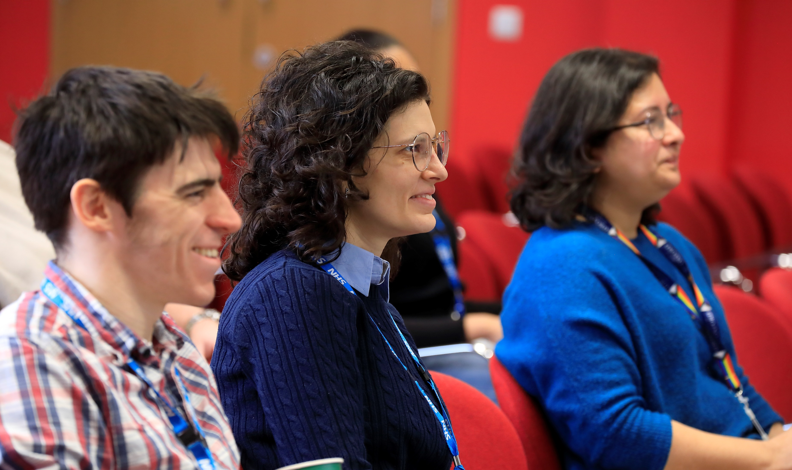
NEW RDM Open Forum
24 February 2025, 12.00-1.30pm, WIMM Seminar Room
For all staff and students in RDM
Hear from senior managers about new initiatives
Ask questions online or in person

Slide 2
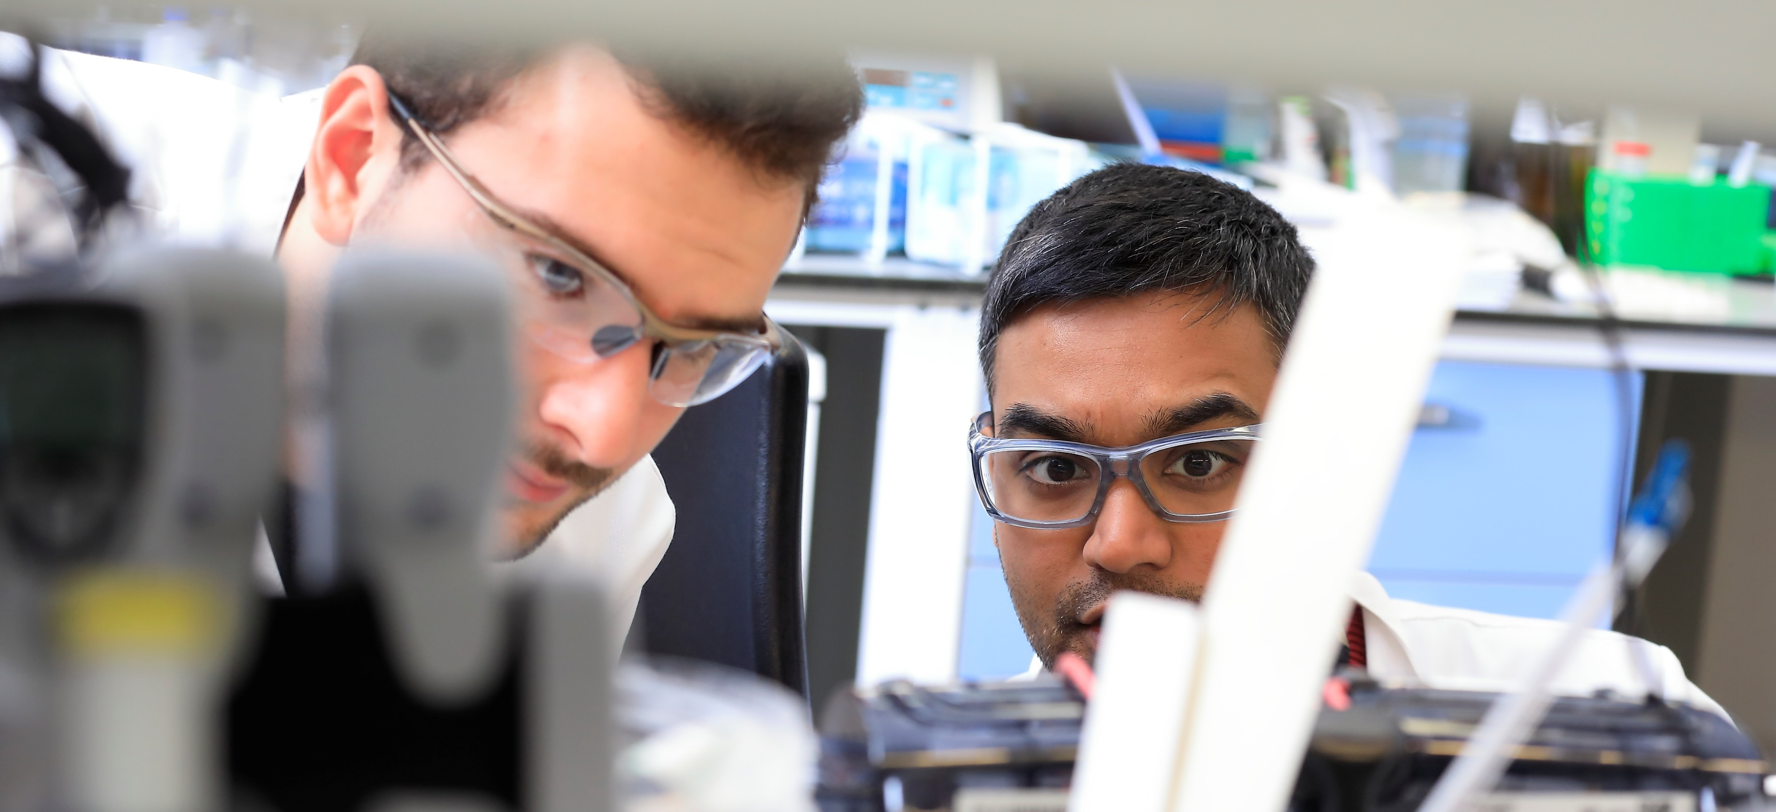

Creating a Research Strategy for RDM
Professor Keith Channon

Slide 3
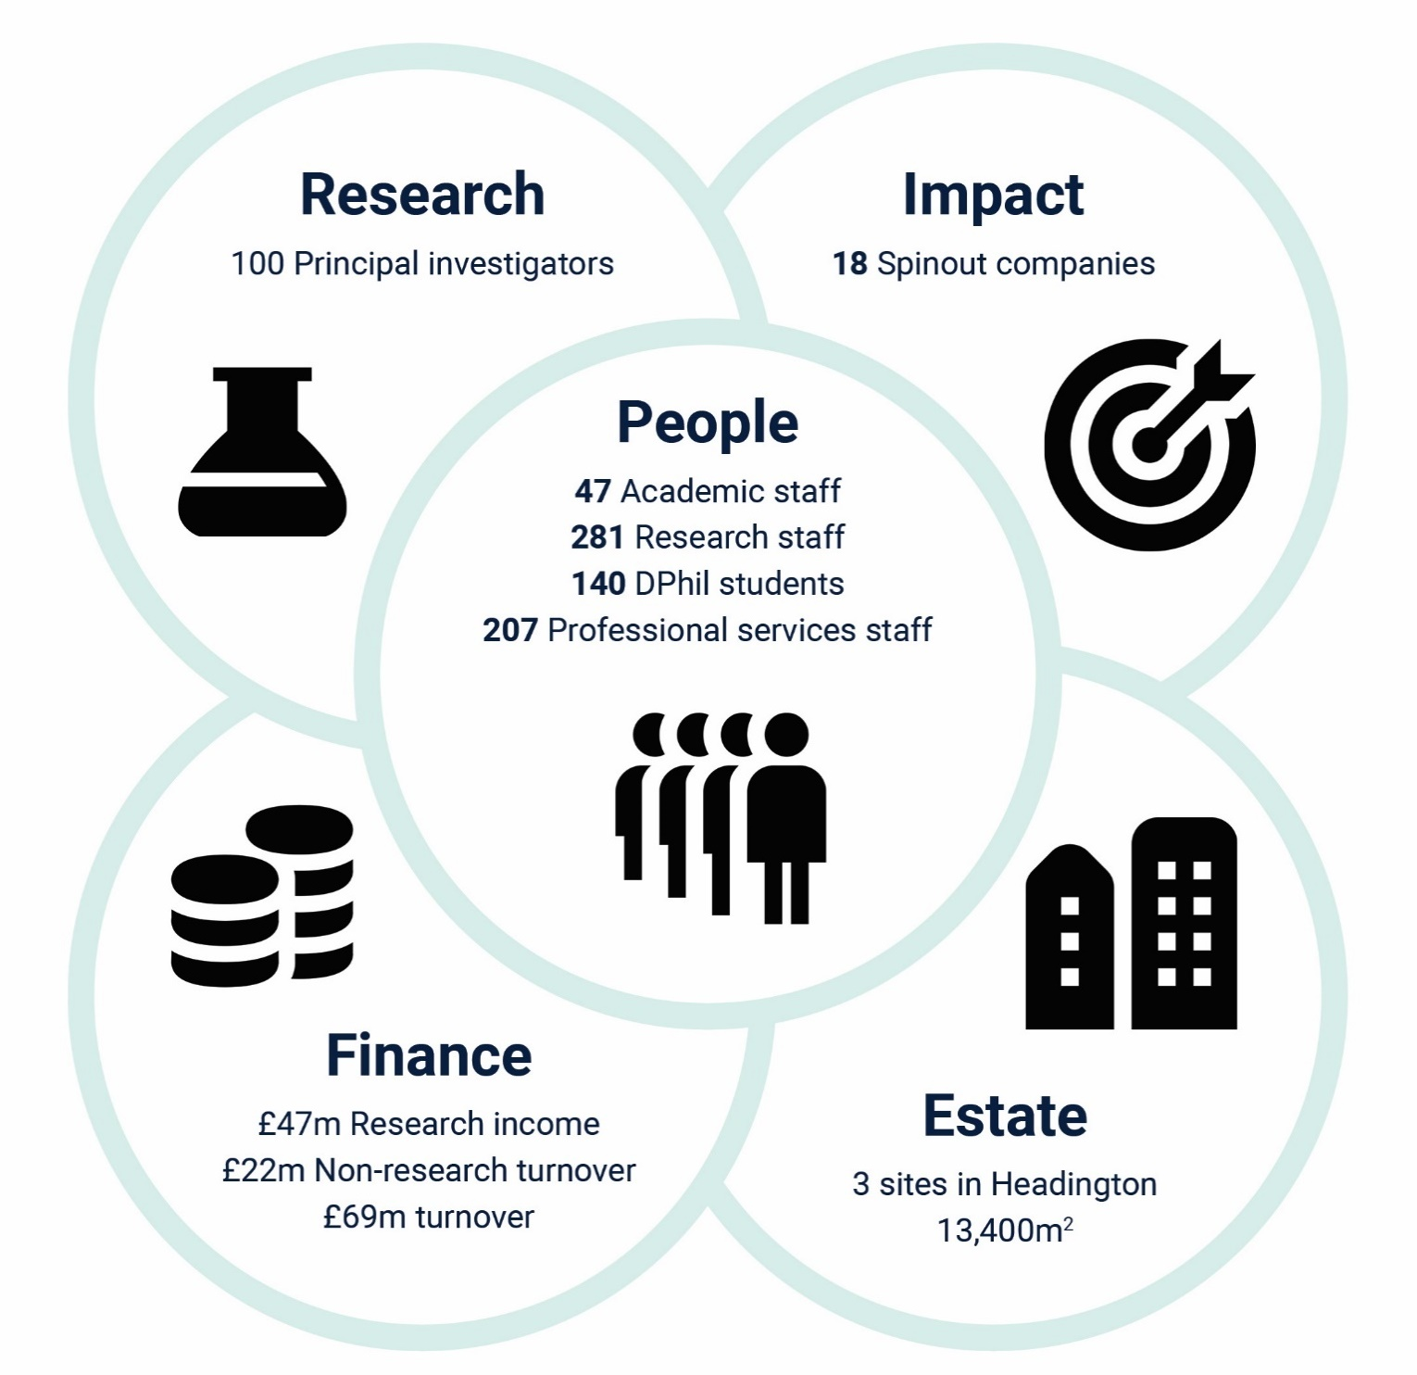
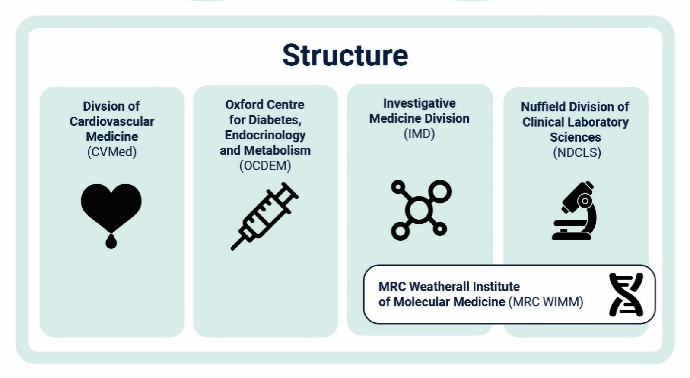
Departmental review
Last year we had our departmental review
We prepared a lot of material for the panel, including these graphics
*
*Administrative (59); PA/EA (15); research support (97); technical, operational, facilities (36)

Slide 4
Recommendations from the review
We are expecting to receive written recommendations from the review panel within the next two weeks
Verbal feedback from the panel indicated that creating and implementing a research strategy should be a top priority
Having a strong statement about what areas our research covers, and what we want it to achieve, will help us attract people and funding

Slide 5
What have we done about this so far?
As part of our preparations for the departmental review we engaged external consultant John Hatwell
John interviewed representatives from different staff groups about RDM’s strengths, challenges and opportunities
He facilitated two workshops to discuss these ideas further, and gained input from RDM’s Senior Leadership Team

Slide 6
Our new vision and mission
This activity led to the articulation of our vision and mission:
Our vision is to use science to support a healthier, longer life for all
Our mission is to improve health through cross-disciplinary research to understand shared mechanisms of disease, and to accelerate the transition from scientific discovery to clinical care

Slide 7
What are the next steps?
We are planning a meeting after Easter to gain input from RDM representatives as we finalise the research strategy
We will make sure that the strategy is a practical document that we can deliver on

Slide 8
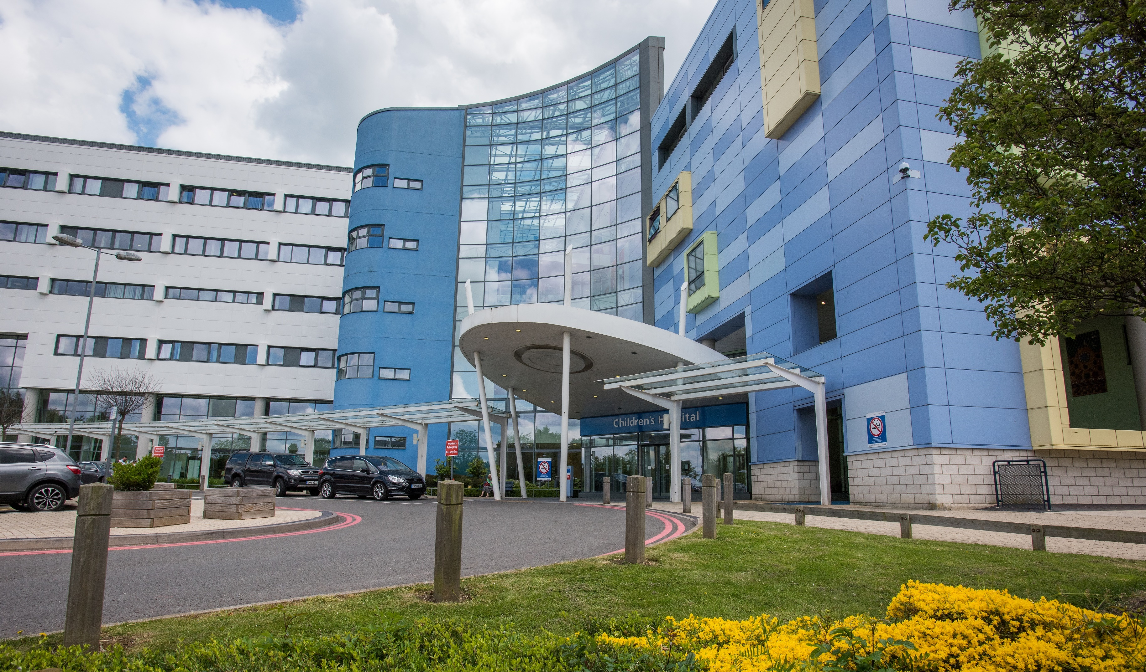
Creating an Estates Strategy for RDM
Professor David Ray
Notes:
Addressing the challenges relating to our buildings and space is another issue the review panel considered important.

Slide 9
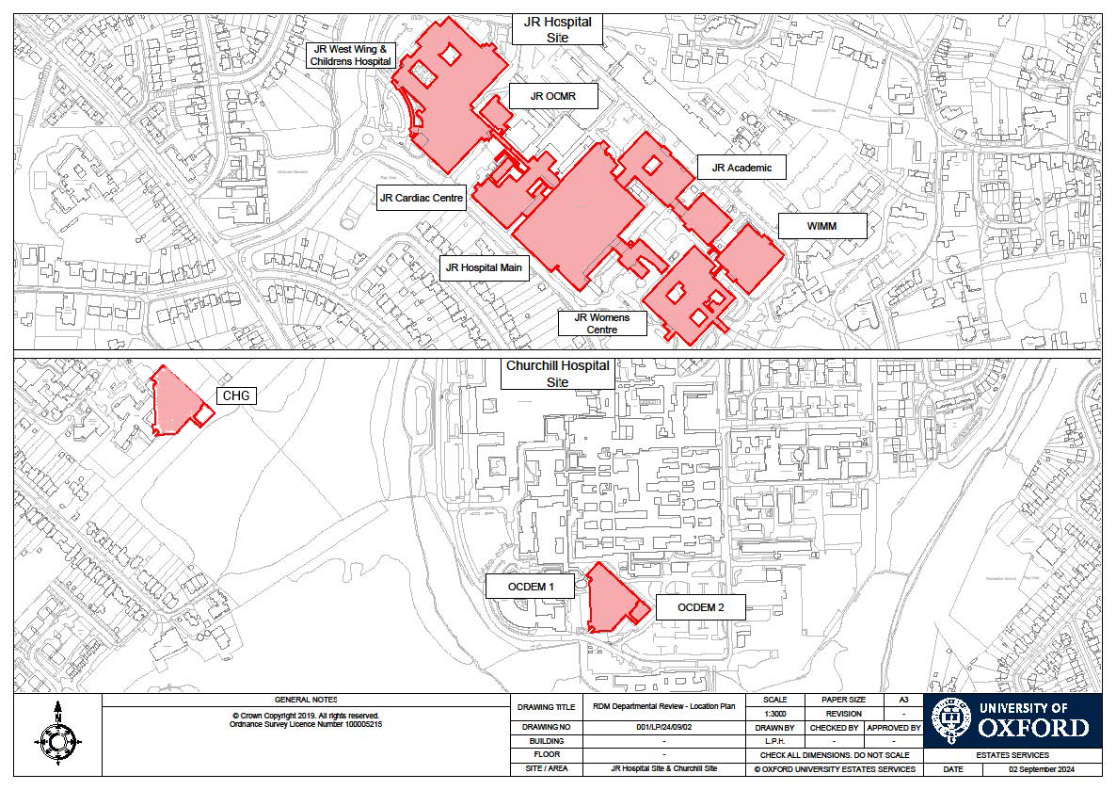
What is our estate?
13,400 m²
or
two football pitches

Slide 10
What is our estate?
A mix of University-run buildings built on OUH estate, and fully embedded leased space in the JR and Churchill Hospitals:
The JR site (two levels in the West Wing, six levels in the main hospital, and the MRC WIMM building and adjacent space in the Women’s Centre)
The Old Road campus, with laboratories and animal facilities in the Nuffield Department of Medicine’s Centre for Human Genetics
The Churchill site, the location for the Oxford Centre for Diabetes, Endocrinology and Metabolism (OCDEM)

Slide 11
What are our challenges?
Our facilities are of variable quality
Much of our space is embedded in OUH space
OUH has its own challenges in terms of maintaining its space.
There are unclear lines of responsibility for repairs and maintenance.
Some capital projects are lengthy, leading to cost overruns and missing provision.
Not all our PIs and graduate students are in the space that they need
A coordinated approach to health and safety is hard to achieve across our multiple sites

Slide 12
How are we going to solve them?
The Departmental Review panel indicated the importance of maintaining the infrastructure to support leading-edge science.
Therefore we are:
Setting up an RDM Space and Capital Projects Committee to support the review and management of RDM’s spaces now and in the future
Providing input to the current review of JR and Churchill embedded space being run by MSD and University Estates
Welcoming the new University Estates Director, Trevor Payne, who is coming to visit OCDEM on 26 February and the JR on 24 April

Slide 13

Staff Experience Survey
Emma Engel

Slide 14
What is the survey and why does it matter?
It’s the main way the University can receive feedback from employees
It’s run by People Insight every two years
It informs strategy to improve the working environment
Insights from the survey contribute to these submissions:
REF 2029
Athena Swan
Race Equality Charter

Slide 15
How did the last survey effect change in RDM?
Identified areas
Actions
● RDM Leadership Programme ● New Academic Career Panel ● New Intermediate Fellowship Framework ● Relaunched Career Development Committee
Career development
Management & leadership
● PDR/CDR to launch in spring 2025
● Improved RDM Bulletin ● RDM Blog ● RDM Open Forum ● More reps on RDM Committees
Communication & transparency

Slide 16
How did the last survey effect change in the University?
Identified areas
Actions
Pay and benefits
● Pay and conditions review
Professional & career development
● Careers Club (PSS) ● InRehearsal ● Technicians Commitment ● Academic Career and Reward Framework ● New module for researchers to initiate and manage their PDR/CDR
Balanced workload
● Strategic Review of Professional Services ● Digital Transformation
● Thriving at Oxford ● Work-Related Stress Policy
Aspects of inclusion and leadership
● EDI Strategic Plan ● Report+Support ● People Strategy ● MSD Mediation Service

Slide 17
How will the survey run in 2025?
You will receive an email invitation to take part in the survey from People Insight on 31 March
You will have three weeks to respond
We will ask PIs to set aside time during lab meetings for people to fill in the survey
We have included a question about your main location, so that we can interpret feedback in the context of specific environments
You can be confident that the survey is entirely anonymous
Analysis will be completed by the end of June for dissemination and action planning

Slide 18
We want to hear from you!
With your feedback we will be able to:
Continue to improve departmental working culture
Attract, develop and retain the best people
Bring in funding to grow our research
Achieve our vision to use science to support a healthier, longer life for all

Slide 19
Any questions?
We have half an hour for questions about these presentations or anything to do with the running of RDM.
After that lunch is available for those attending in person.

